Slide 1
Notice of Adverse Benefit Determination (NOABD)

Slide 2
What is a NOABD?
Previously called Notice of Action (NOA)
Formal way to inform a member of a denial or change to their BHRS services and their right to request an appeal if they do not agree
Renamed in Federal law (CFR 42 §438) and California law (CCR 9 §1810)
Department of Health Care Services templates and attachments limit customization
Must be used anytime we limit, deny, terminate or delay a service for a Medi-Cal member
BHIN 25-014 NOABDs

Slide 3
Purpose of the NOABD
Tells Medi-Cal members, in writing:
    What we did (or if we did it on time)
    Exactly why we did it
    What they can do about it
    What their rights are and how we protect their rights

Slide 4
BHRS Policy 33 Notice of Adverse Benefit Determination (NOABD) to medi-cal members
https://hhs.marincounty.gov/services/behavioral-health-contractor-resources
BHRS 33 NOABD
Who does it apply to?
    All BHRS and contractor staff!

Slide 5
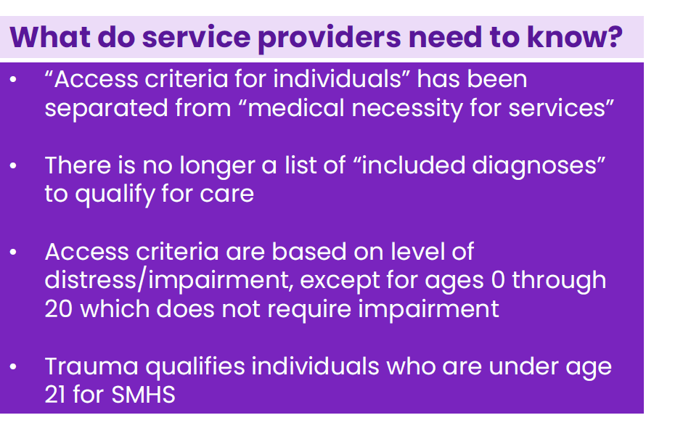
Access to Specialty Mental Health Services
Access to guidelines revised in 2022
BHRS 120 Criteria for Access to Integrated Behavioral Healt Plan Services, Medial Necessity and other Coverage Requirements

Slide 6
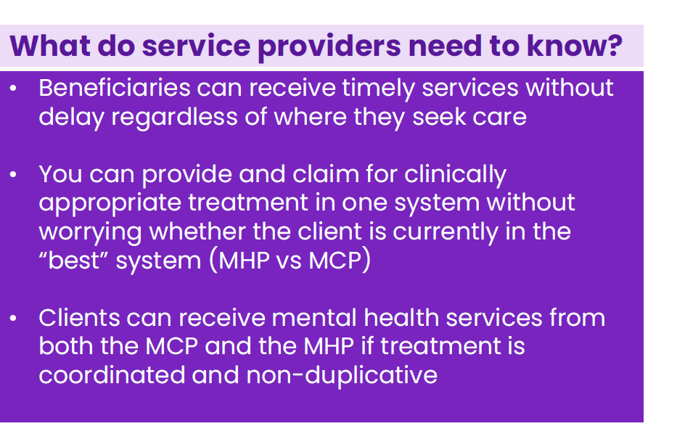
No Wrong Door for Mental Health Services
July 1, 2022
People can easily access services through both the Mental Health Plan (MHP=BHRS) as well as the Managed Care Plan
BHRS 92 No Wrong Door for Mental Health Services

Slide 7
Purpose of the NOABD
Tells Medi-Cal members, in writing:
    What we did (or if we did it on time)
    Exactly why we did it
    What they can do about it
    What their rights are and how we protect their rights

Slide 8
Informing the Member
Members must receive a written NOABD when we take an action.
Decisions should be communicated first by telephone or in person, then in writing (except for decisions rendered retrospectively).
Timing of the Notice: BHRS must mail the notice to the member within the following timeframes:
1. For termination, suspension, or reduction of a previously authorized specialty mental health and/or DMC-ODS service, at least 10 days before the date of action,except as permitted under 42 CFR §§ 431.213 and 431.214;
2. For denial of payment, at the time of any action denying the provider’s claim;
3. For decisions resulting in denial, delay, or modification of all or part of the requested specialty mental health and/or DMC-ODS services, within two business days of the decision. BHRS must also communicate the decision to the affected provider within 24 hours of making the decision

Slide 9
Workflow
Smartcare- enter required information in correct NOABD template, print, send to client with required attachments.
https://2023.calmhsa.org/how-to-complete-a-noabd/

Slide 10
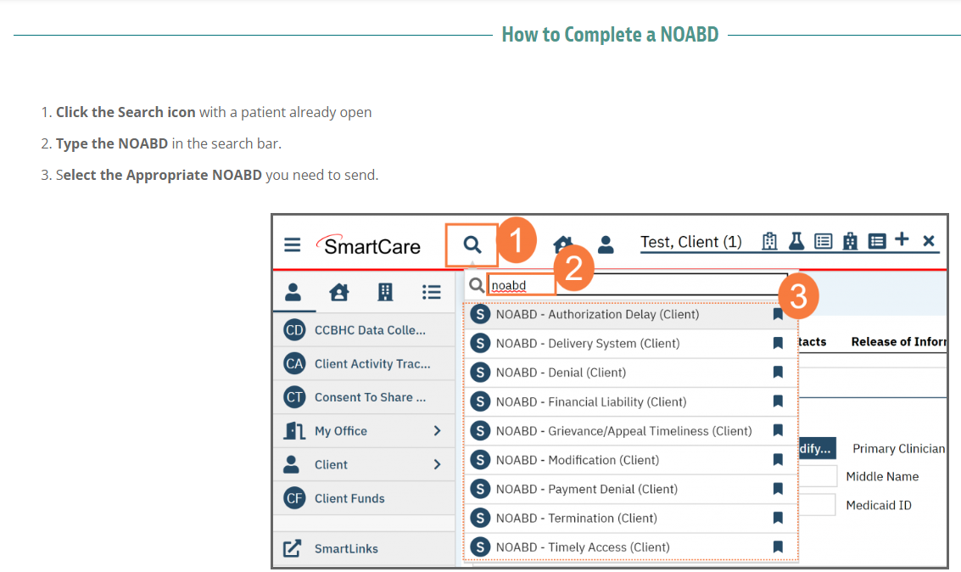

Slide 11
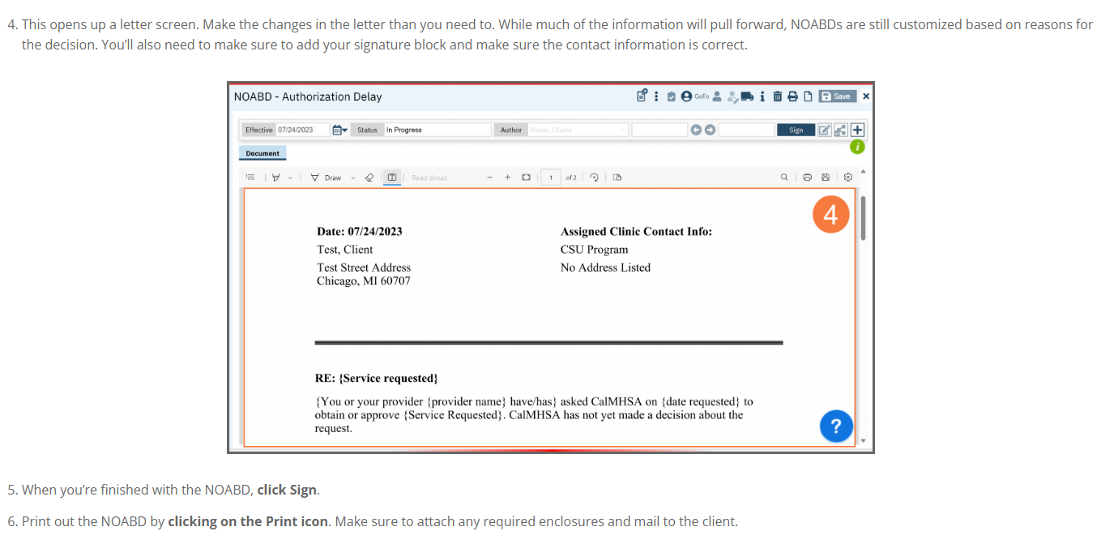

Slide 12
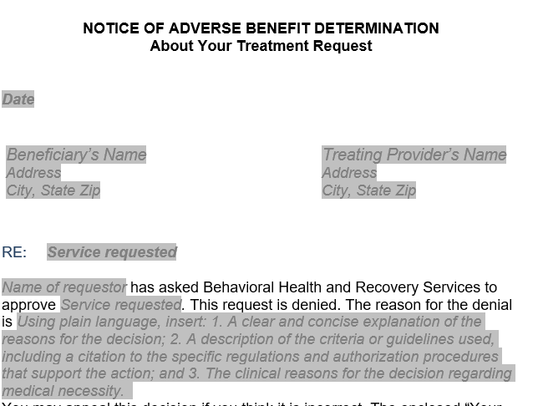

Slide 13
What goes in the text box?
Reason(s) for the decision, written in plain language, not jargon
For medical necessity criteria
  Which criteria?
  Why not?
Ratings that support decision
  CANS
  Pediatric Symptom Checklist (PSC)
  ASAM

Slide 14
ATTACHMENTS
To All Members,
Always!
Three attachments will be enclosed when sending any NOABD to a member:
  “Your Rights” -informs appeal, expedited appeal and State Hearing rights, along with the problem resolution process.
  member Non-Discrimination Notice- informs members of the way their rights are protected.
  Notice of Availability-language Assistance Taglines -16 different languages

Slide 15
NOABD Denial Notice (Denial of requested service by a member or Provider)
Action: | Sent to member (and provider, when the request comes from a provider) when we deny a request for a service. Similar to the former NOA A. Lack of medical necessity for a type or level of a service based on: Excluded diagnosis Intervention won’t help (not likely to reduce impairment or prevent deterioration) Wrong level of care: Requests a network provider, but cannot safely be treated in a private office

Slide 16
Sample NOABD Denial Notice
“Based on your report that neither you nor family members have a history of significant mental illness and that the upsetting visions and thoughts you experience began after a period of heavy substance use, we do not believe that you qualify for specialty mental health services.

Slide 17
NOABD Other Level of Care Notice
Action: | member needs a service, but not Specialty Mental Health Services (SMHS). This NOABD to be done every time we refer to a lower level of care, even if the client is, at the time, in agreement with the referral/step down to a lower level of care. Refer to Carelon, Managed Care Plan Non-SMHS

Slide 18
Sample NOABD Other Level of Care Notice
“We will refer you to Carelon for therapy because, based on our assessment, we believe that your depression can be treated by discussing medication with your primary care doctor and by participating in outpatient therapy. We believe that you are seeking treatment early and have many positive supports and strengths that will help you in treatment before your symptoms become overwhelming. At this time, you do not meet criteria for access to Specialty Mental Health Services (SMHS) per BHRS 89 policy Criteria for member Access to Specialty Mental Health Services, medical necessity and other coverage requirements.

Slide 19
NOABD Timely Access Notice (Delay in access)
Action: | Sent to member when there is a delay in providing the member with timely services. Similar to the former NOA E, but applies to follow up care, too! Initial appointment (MH and DMC-ODS) Routine = within 10 business days of request Urgent = within 96 hours of request Crisis = within 48 hours of request First offered treatment service after the assessment must be within 10 business days of assessment start date. Psychiatric assessment within 15 business days of written request

Slide 20
NOABD Authorization Delay Notice
Action: | Sent to member when there is a delay in processing a member’s or a provider’s request for authorization of behavioral health services. Examples: Delay in authorizing SMHS (must be within 5 Business Days of the Assessment Start)

Slide 21
NOABD Termination Notice (Termination of previously authorized services)
Action: | Sent to member and provider when BHRS terminates, reduces or suspends a previously authorized service (or ends treatment that a client still wants) Mental Health: 1. Planned, successful terminations (document in Smartcare): No NOABD 2. Unplanned terminations/client withdraws Document outreach calls and send NOABD Termination 10 business days prior to closure (can be instead of Call/Close letter)

Slide 22
Sample NOABD Termination Notice
“We are ending your services because you have not kept an appointment with us since 12/02/2022. We will close your case on 1/31/2025 unless you call your provider to schedule an appointment.”

Slide 23
NOABD Modification Notice
Action: | Sent to member and provider when we modify or limit a provider’s request for a service. Similar to the former NOA B. Examples: Reduce frequency and/or duration of services Deny a request for alternative treatments and services

Slide 24
Sample NOABD Modification Notice
“Your Network Provider, Sally Therapist, asked us to authorize therapy for you 3 times per week for the next 3 years. Instead, we authorized 16 therapy sessions for you for the next four months. Your provider may document the need for additional services before this authorization ends and we will review her request.”

Slide 25
NOABD Payment Denial Notice (Denial of payment for services rendered)
Action: | Sent to the member and provider when we deny, in whole or in part, for any reason, a provider’s request for payment for services that have already been delivered to a member. Similar to the former NOA C.

Slide 26
Sample NOABD Payment Denial Notice
The progress notes submitted by Sally Therapist for the dates of service listed do not meet BHRS’s documentation standards. Please refer to the Documentation Guidelines for detailed directions. Specifically, the progress notes we denied do not meet the Title 9 definition for therapy (California Code of Regulations, Title 9, §1810.250) and do not document that you provided an intervention that would diminish the client’s impairment or prevent deterioration in functioning (CCR, Title 9, §1830.205 (b)(3)(A-C)).

Slide 27
NOABD Financial Liability Notice
Action: | Sent to the member when BHRS denies a member’s request to dispute financial liability, including cost-sharing and other member financial liabilities.

Slide 28
Sample NOABD Financial Liability Notice
While we understand that your Share of Cost is a burden to you, we are not permitted to adjust your Share of Cost or claim reimbursement from Medi-Cal until your Share of Cost obligations are met (California Code of Regulations, Title 9, §1810.345 and Title 22, §50651-50659). Please work with the Department of Social Services to see if you qualify for a type of Medi-Cal that has no Share of Cost.

Slide 29
NOABD Grievance and Appeal Delay Notice
Action: | Sent to the member when BHRS does not respond to a grievance or appeal in a timely manner
Used by Quality Management staff only

Slide 30
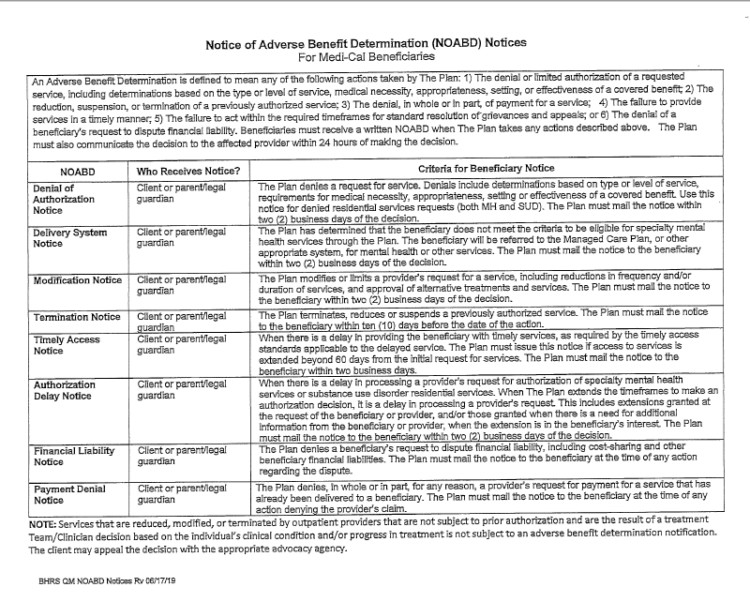
https://www.marinhhs.org/mental-health-services-contractor-resources
Use the NOABD TABLE to figure out which NOABD to send

Slide 31
Where are they?
Sept. 2023- in Smartcare!
Spanish versions coming soon.
https://hhs.marincounty.gov/services/behavioral-health-contractor-resources

Slide 32
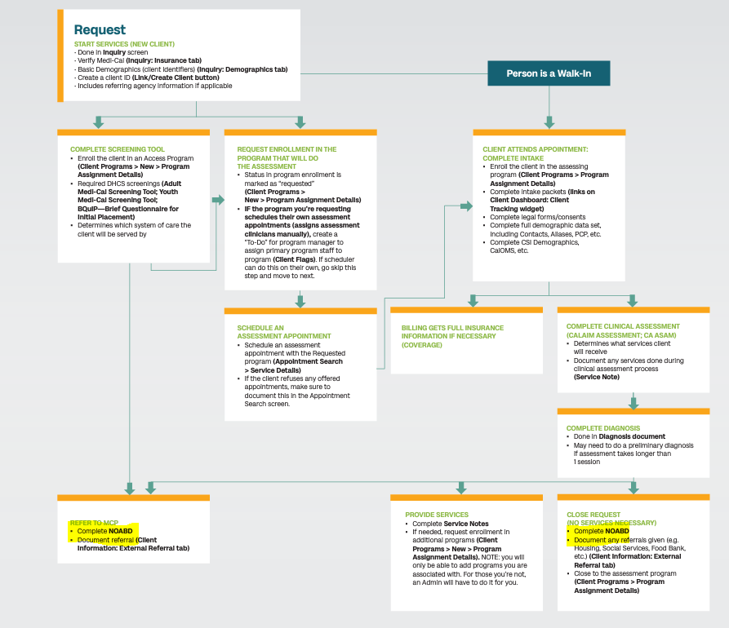

Slide 33
Questions?
Steve Wilbur, LMFT, CHC
Quality Improvement Coordinator
BHRSQM@marincounty.gov

