Slide 1
Behavioral Health Board
BHRS Director’s Report
May 12, 2026
Todd Schirmer, PhD, CCHP

Slide 2
May Mental Health Month
Full list: https://prevention.marinbhrs.org/MMHM2026
Finding help and hope: Stories of crisis and recovery
  Thursday May 14, 6-7:30 at College of Marin
  Speaker: JD Schramm
  Hosted by NAMI Marin and Men and Boys Action Team

Slide 3
Requests for Proposals
BHSA Requests for Proposals (RFPs) are being released on a rolling basis: https://www.marincounty.gov/contracting-opportunities
Awarded
Early Intervention for Youth: Early Childhood and School Age: First 5 Marin/Help Me Grow; Huckleberry Youth Programs, JFCS, Marin City Health & Wellness, North Marin Community Services
Early Intervention: Communities, Compassion to Action, Caring Connections: North Marin Community Services, Marin City Health & Wellness, Canal Alliance, Center for Domestic Peace, First Missionary Baptist Church, YLI, MCM, Opening the World, Vietnamese American Culture Center of North Bay, NAMI Marin, JFCS, Buckelew Programs, Felton Institute, Huckleberry Youth Programs
Peer Support / Peer Drop-In Services: MarinCreates / MHAM
TAY FSP Intensive Case Management and Coordinated Specialty Care: Side by Side
Family Support Services: Mental Health Association of SF

Slide 4
Requests for Proposals
BHSA Requests for Proposals (RFPs) are being released on a rolling basis: https://www.marincounty.gov/contracting-opportunities
Recently closed
Scattered Site Assisted Independent Housing (closed 4/17/26)
Individual Placement and Support for Supported Employment (closed 3/13/26)
Planning
Peer Respite

Slide 5
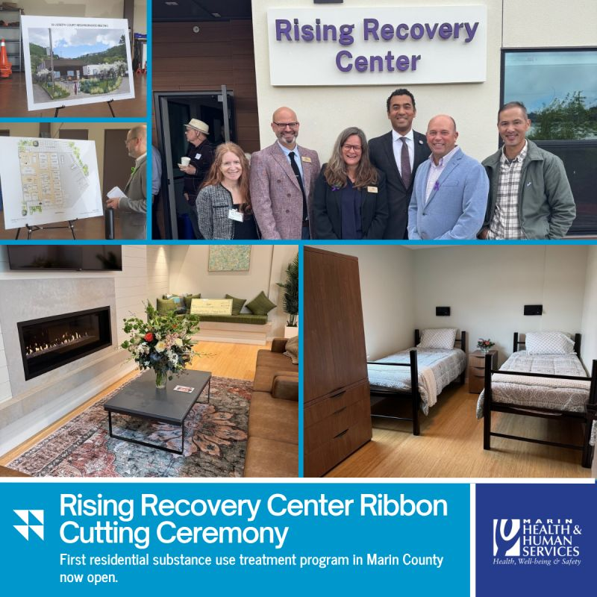
Rising Recovery Center
New 15 bed residential program for people with co-occurring SUD and mental health needs, 45-60 day stay
Operated by Buckelew Programs
Expected to open by the end of the month

Slide 6
New County Website
www.marinhhs.org has transitioned to hhs.marincounty.gov
www.marinbhrs.org has transitioned to hhs.marincounty.gov/divisions/behavioral-health-and-recovery-services-bhrs
Focus on services and ease of access
Consistent design across all Marin County websites

Slide 7
CBH Grants
Innovation Partnership Fund (IPF)
  Replaces the MHSA Innovation component
  Total of $100 million, released $20 million per year in small (under $500k) and large awards (up to $3million)
  HHS (led by Public Health) applying for funding to create a Community Information Exchange (CIE)
  Numerous local CBOs applying for funding
Peer Respite
  Phase 1: Pilot project and learning collaborative, $10 million, awarded August 30, 2026
  Phase 2: Tailored funding to new and existing peer respites, $10 million, awarded June 30, 2028

