Slide 1
Behavioral Health Board
BHRS Director’s Report
July 14, 2026
Todd Schirmer, PhD, CCHP

Slide 2
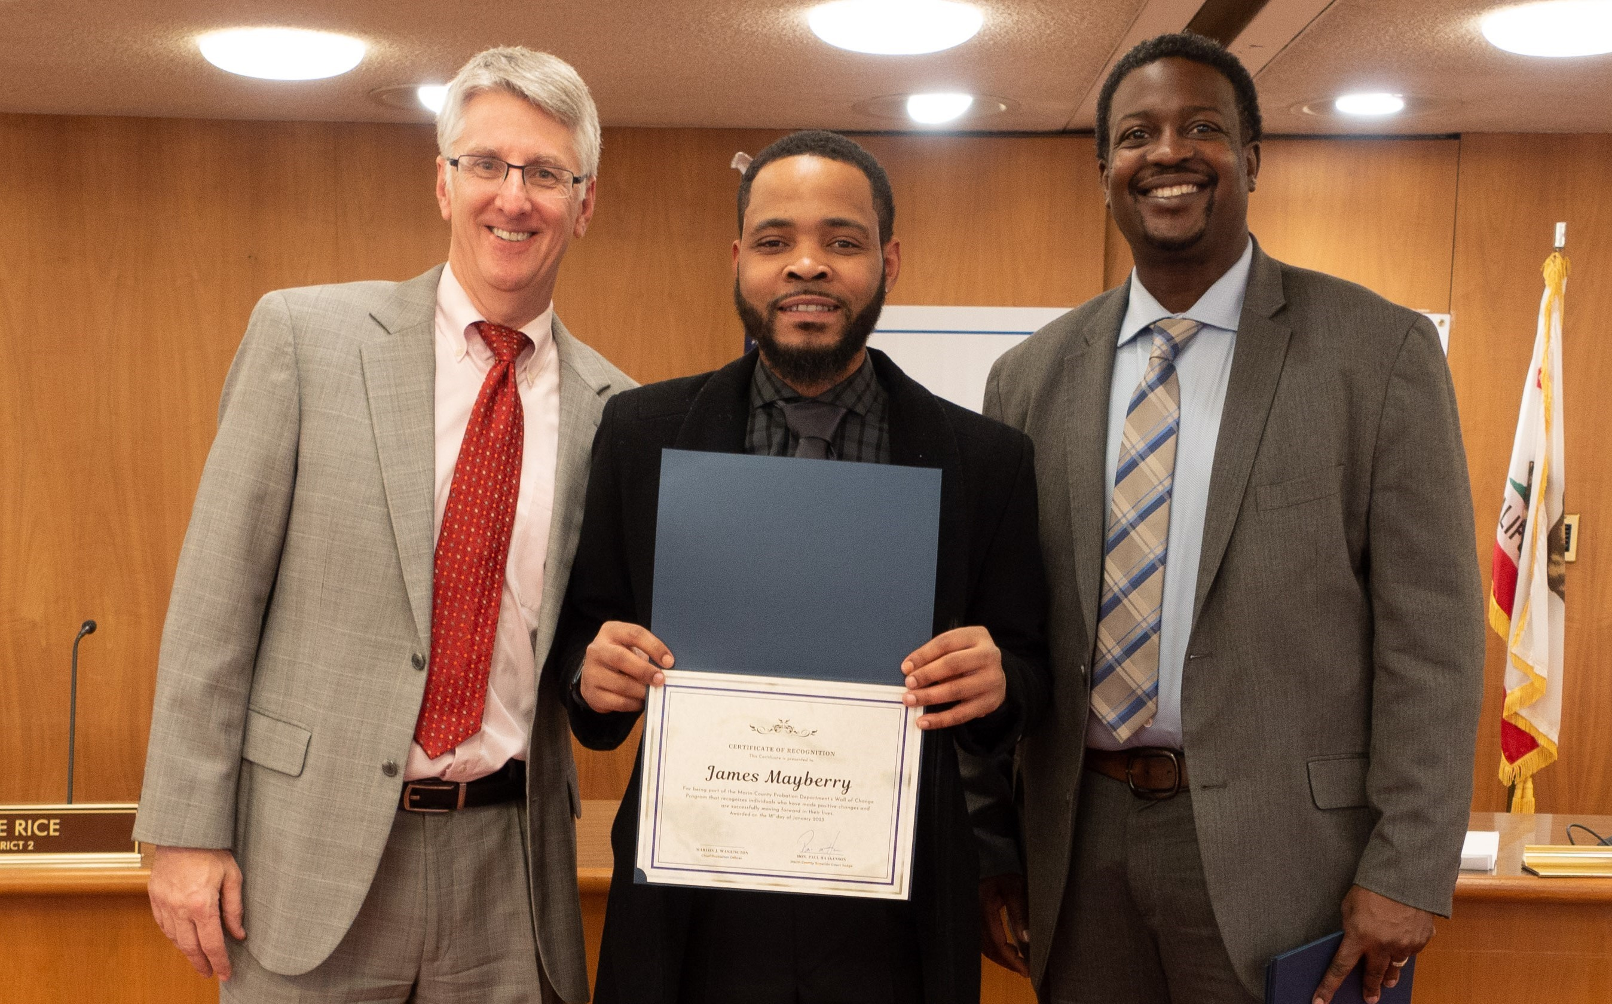
In Memory

Slide 3
State Budget
State’s final budget for next year restores previously proposed cuts to Mobile Crisis. 988 call centers also received funding.
Homelessness Housing Assistance Program (HHAP) received $900 million in funding. Used for permanent supportive housing programs.
Additional support to counties to support implementation of Medi-Cal changes required under HR1

Slide 4
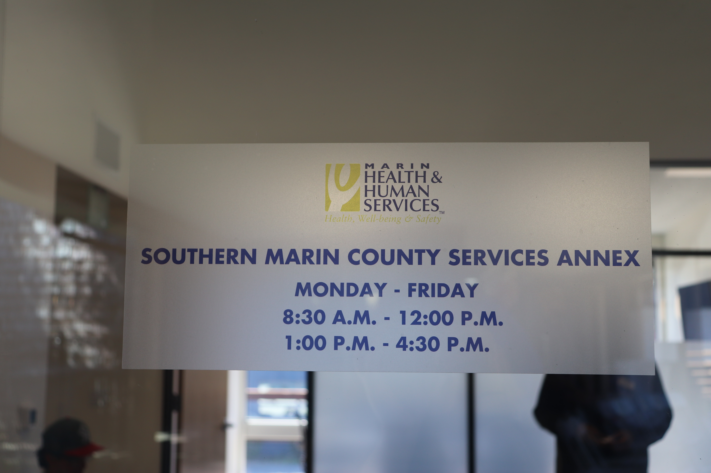
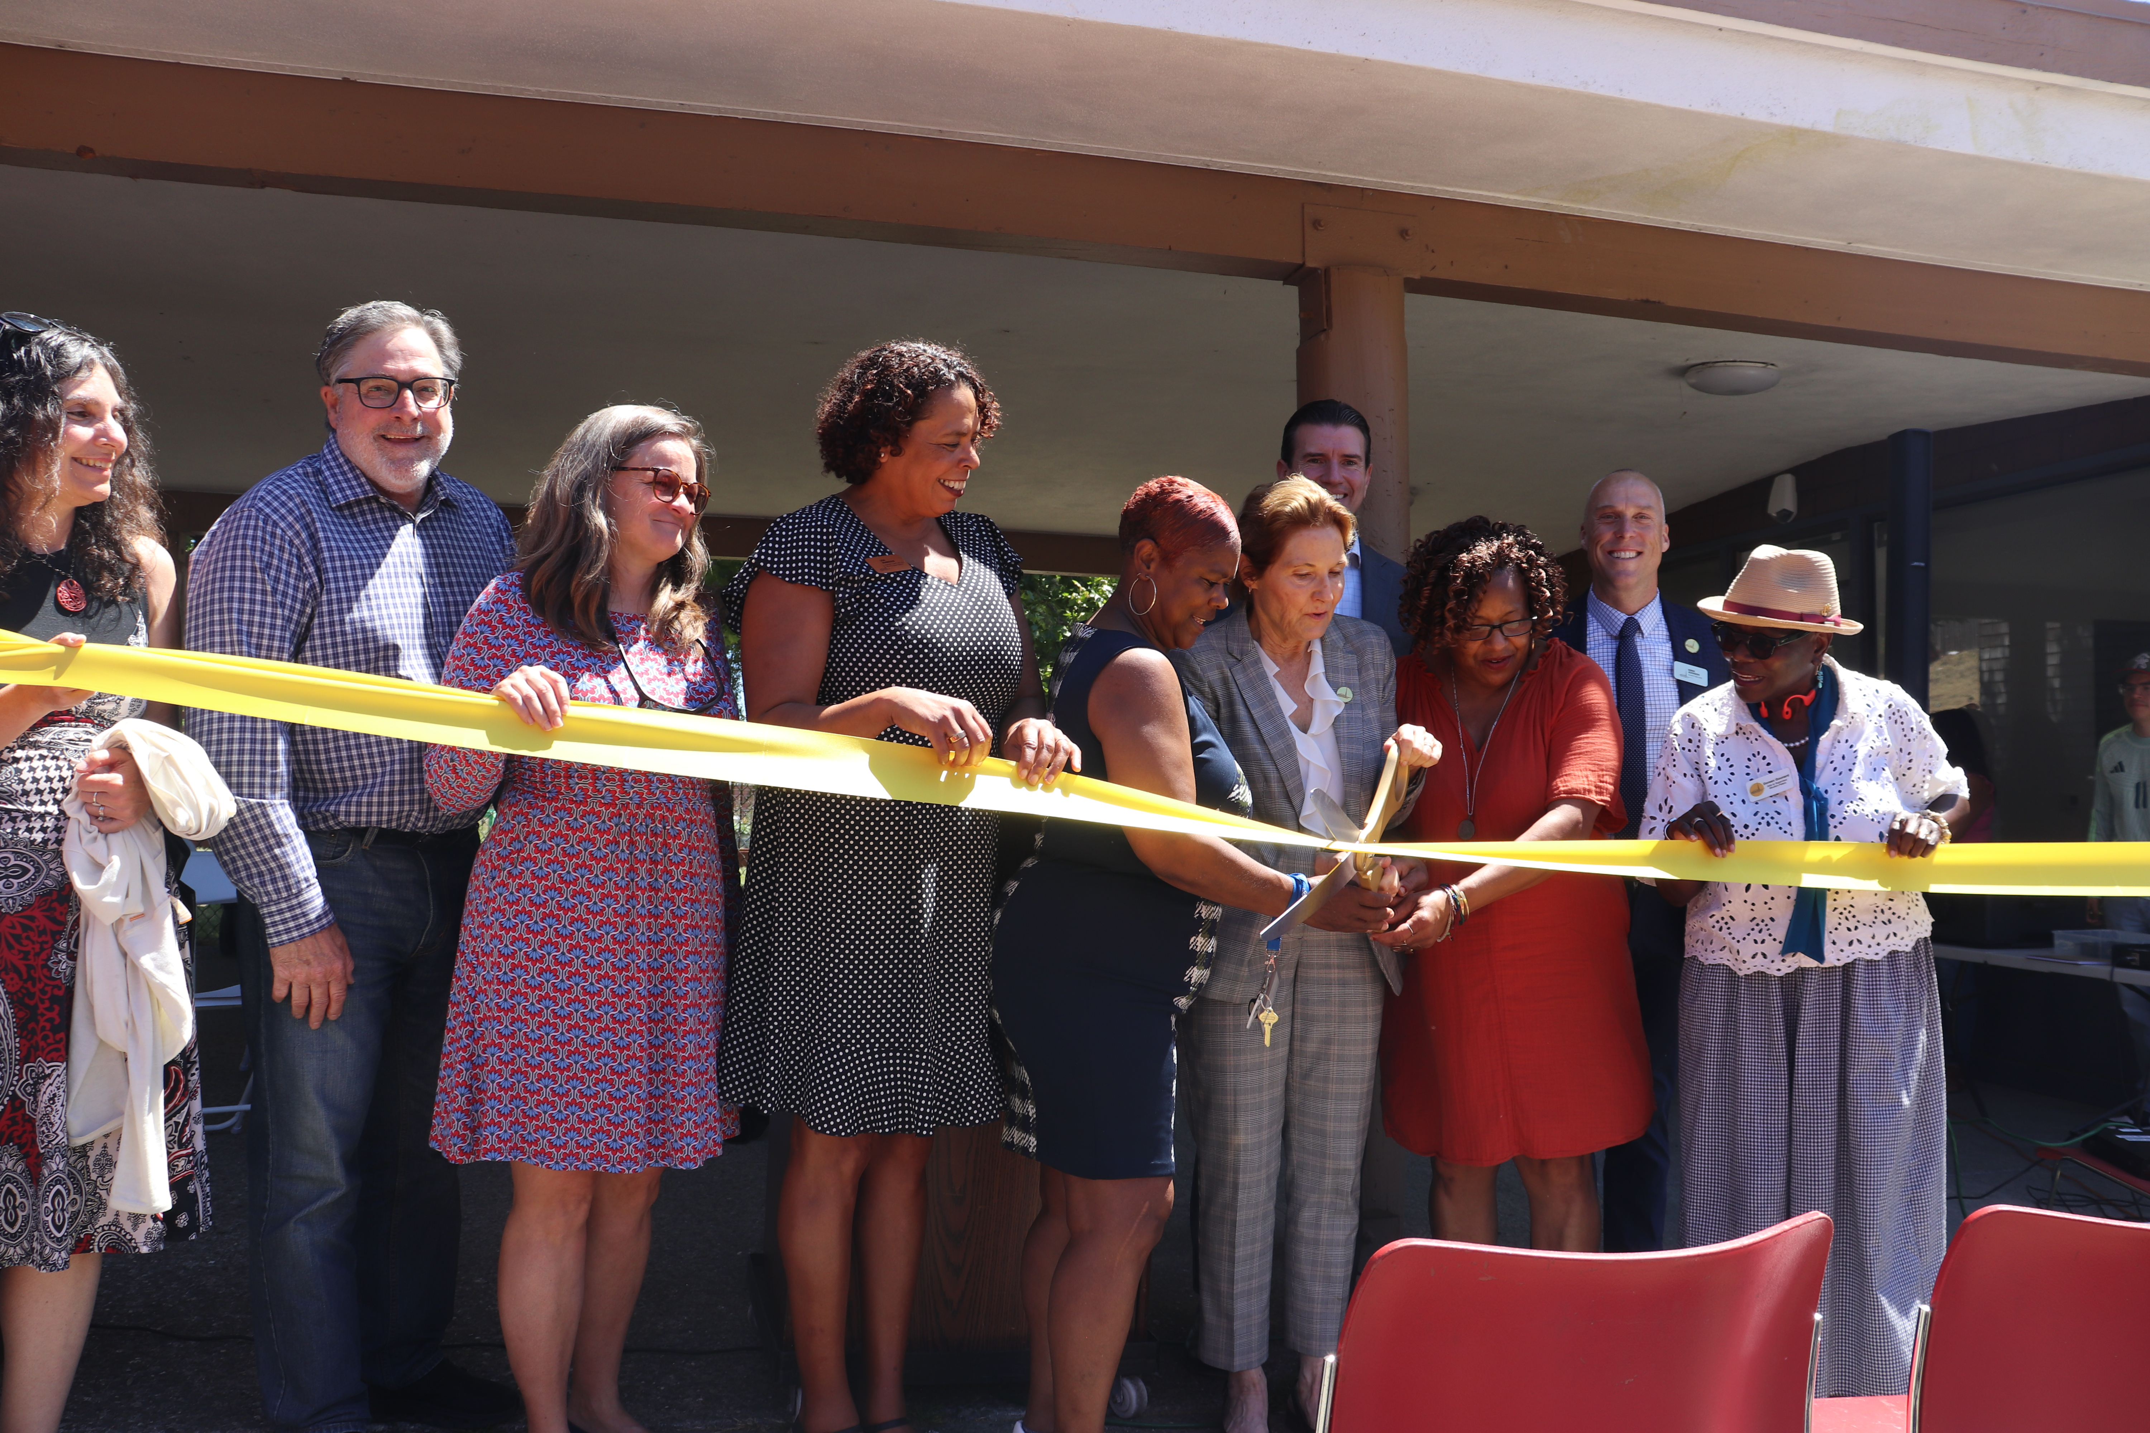
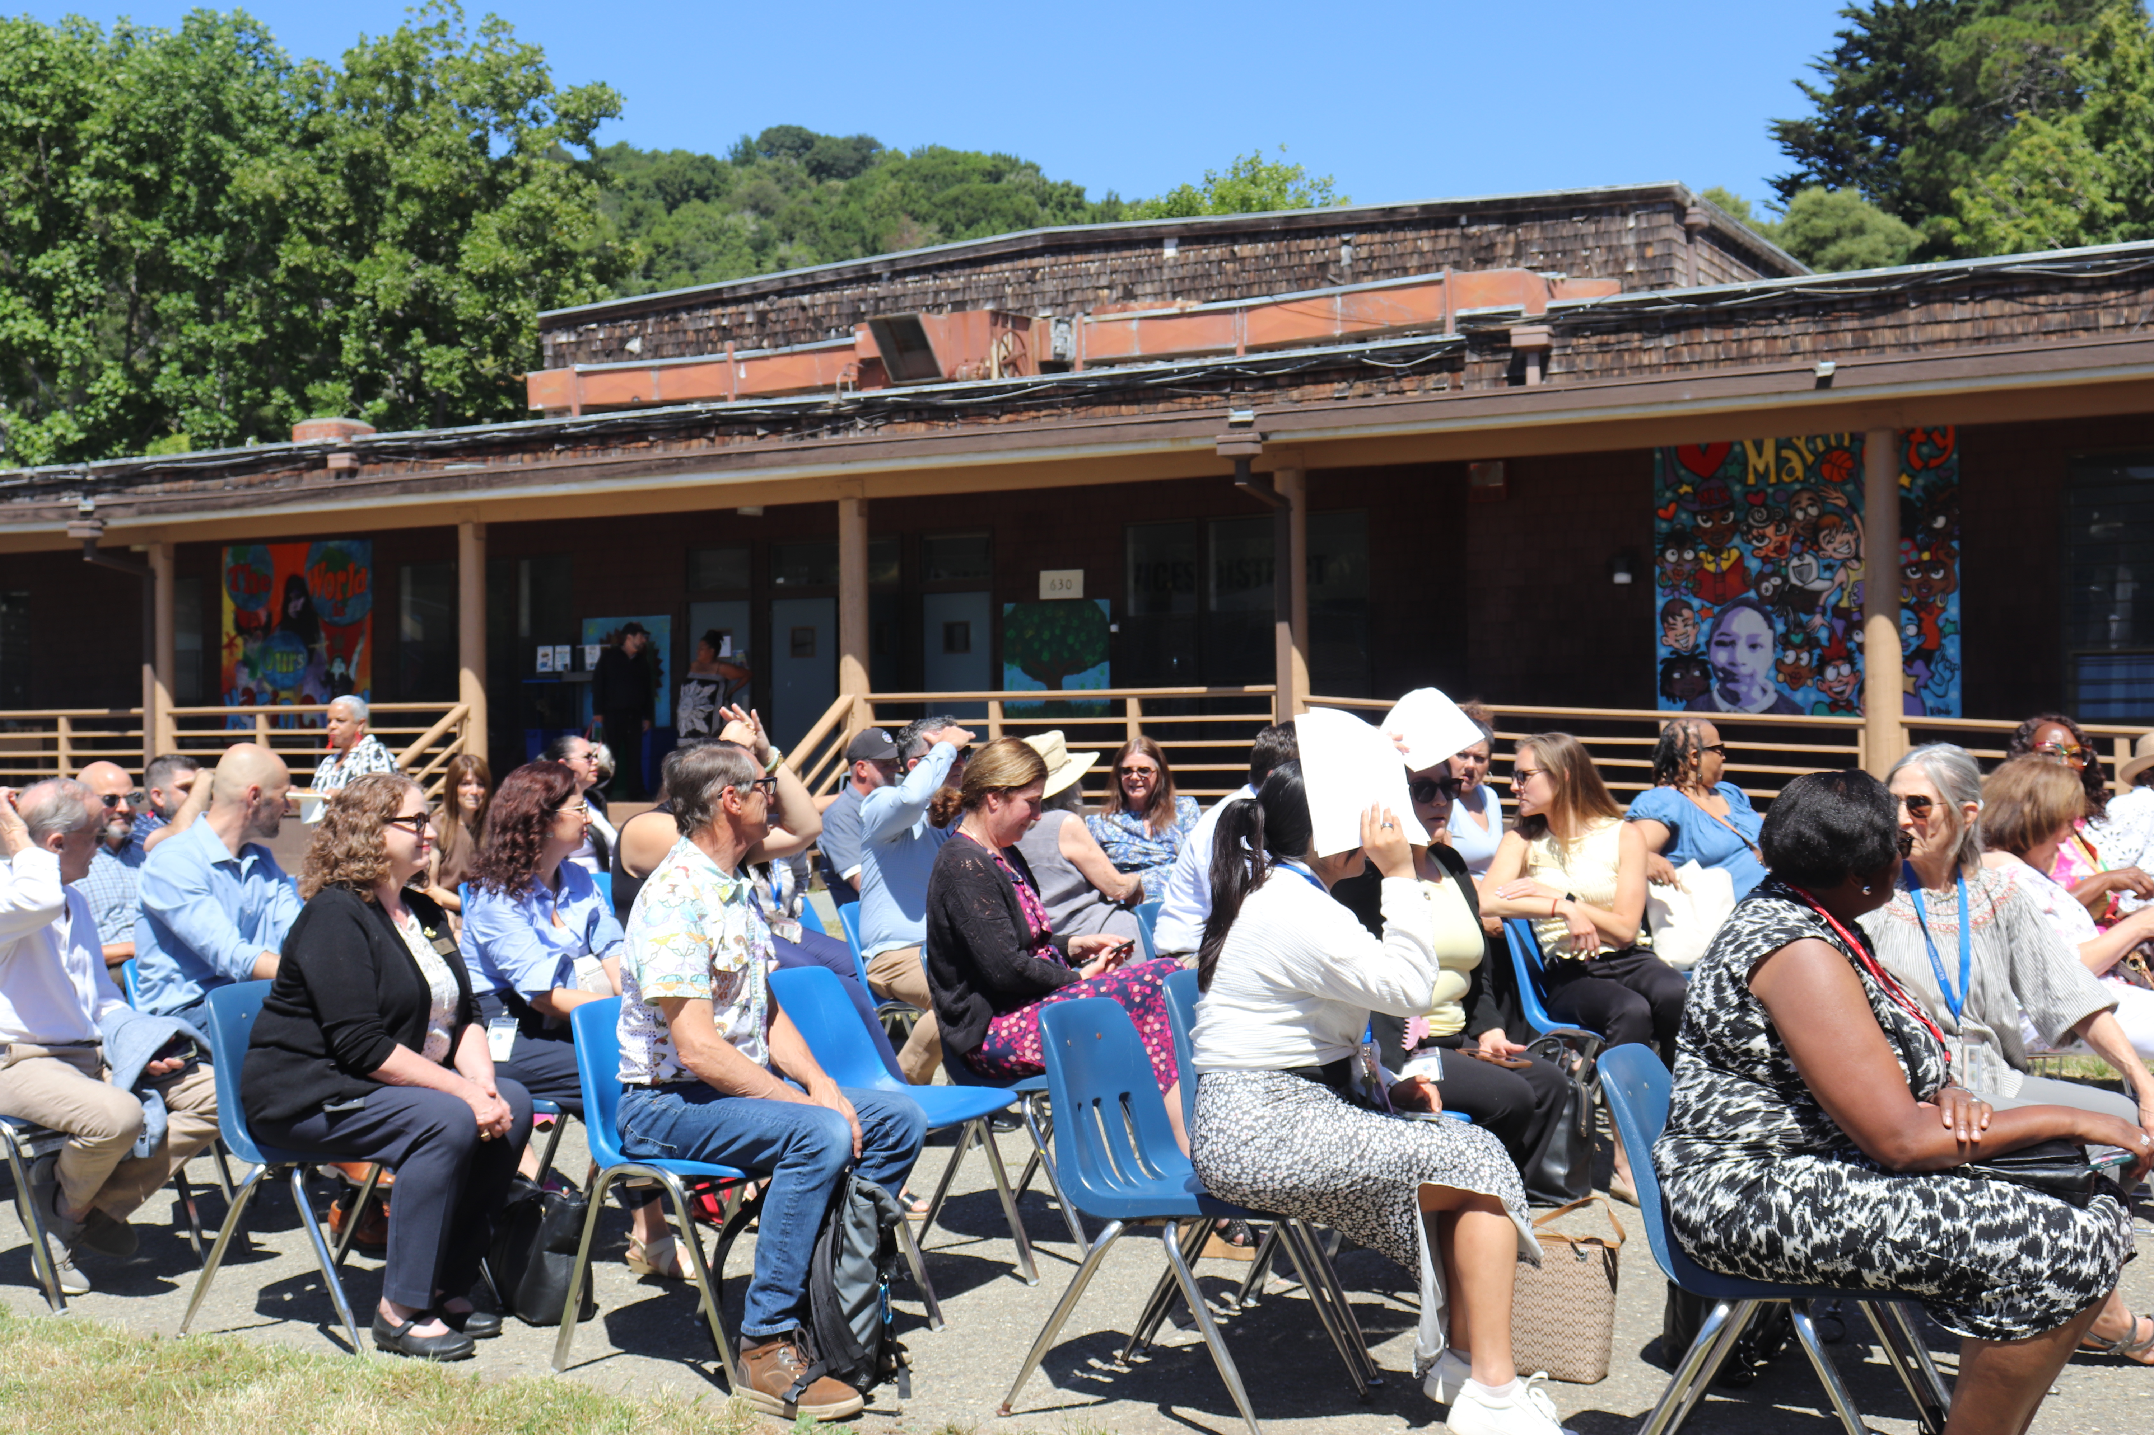
Southern Marin County Services Annex
630 Drake Avenue, Marin City
Officially opened June 11, 2026
BHRS has dedicated space

Slide 5
Rising Recovery Center
Program officially opened July 1, 2026
As of Friday last week, it was nearly full of residents

Slide 6
BHSA Changes
BHSA in effect as of July 1, 2026
New evidence-based practices for adults and youth, including Assertive Community Treatment (ACT) / Forensic Assertive Community Treatment (FACT) model and Individualized Placement and Support (IPS) Model of Supported Employment
Expanded housing options
Early Intervention program expansion with new providers onboarding
Newly eligible primary SUD population
Peer Respite Program planning underway
And more….

