Slide 1

Homeless Policy Steering Committee MAV-SA Adoption
Notes:
Thank you all for coming in-person today
We are here today to launch Marin’s latest vulnerability assessment for CE, the MAV-SA.
want to use this as an opportunity to connect in person across agencies as well

Slide 2


The Problem Being Addressed
Who shows up first to the door to get resources?
Notes:
In our system, like many others, there is one theoretical door
….and there are a lot of folks lined up to that door
Who gets served first and in what order?
Coordinated Entry aims to address this dilemma

Slide 3
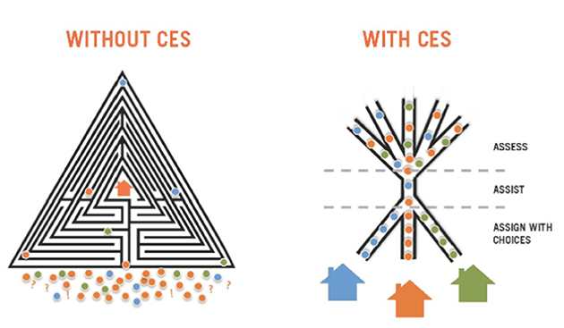
What is Coordinated Entry?
The HEARTH Act and Federal regulations require communities to develop a mechanism for common assessment and coordinated access.
Notes:
Prior to 2017, on the left is what our system would have looked like
Unorganized
Inequitable
Inefficient
Did not prioritize the most vulnerable
In 2017, Marin adopted the system on the right, which streamlines the assessment and matching process

Slide 4
Purpose of Coordinated Entry
To ensure that all people experiencing a housing crisis have fair and equal access and are quickly identified, assessed for, and connected to housing and homeless services based on their strengths and needs.

Slide 5
Marin’s Coordinated Entry System
Entry
Assessment
Match
Placement
Outreach
Assessment completed by Provider Site, Outreach, or Phone
PSH: ongoing case management & rental assistance
RRH: short-term case management & rental assistance
Usual Care: referral to mainstream services
Housing navigation services (e.g., doc prep)
Prioritized transfers as needed
Housing location services (by Marin Housing Authority)
Provider Sites
(415) 473-HOME
What assessment do we use?
Notes:
A client enters the system through a provider site, outreach, or our phone line. We have a no wrong door policy in Marin
Today we will be talking about the second stage, what assessment are we using?

Slide 6


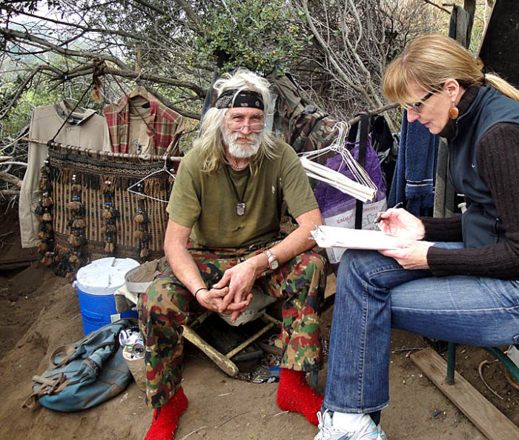
Three Types Coordinated Entry Assessments
MAV-SA (replacing VI-SPDAT)
Family Self Sufficiency Matrix
MAV-TAY (launching later this year)
Notes:
MAV-SA
is what we will be covering today
Family Self Suffiency Matrix
should be used for any clients with dependent children in the household
longer, more in depth, and primarily uses a sliding scale
MAV-TAY
will be launching in the next few months, working with consultants on testing and using the MAV-SA as a baseline
For the TAY providers in the room, we ask that you complete the MAV-SA with any TAY you encounter, and ask a few supplemental questions so that we can do some preliminary testing

Slide 7
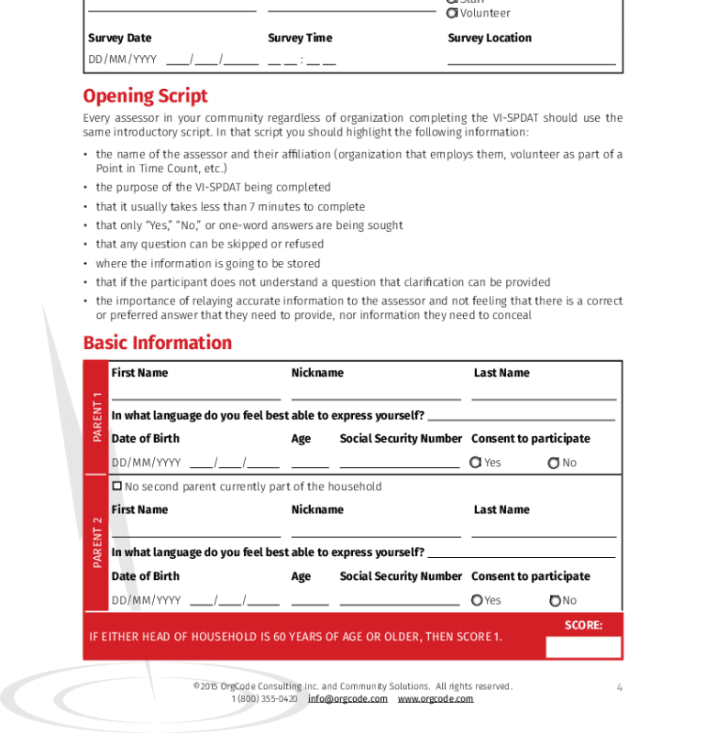
Some Context – Replacing the VI-SPDAT
The VI-SPDAT had been our system's Coordinated Entry assessment since 2017
It served as a standardized tool for Marin and many other communities across the country to determine how to prioritize our unhoused population

Slide 8
Some Context – Replacing the VI-SPDAT
However, following its implementation it became clear there were some major issues, including:
  Racial and Gender bias
  Language that retraumatized clients
These issues became so clear that even the creators of the assessment, OrgCode, no longer supported the tool

Slide 9

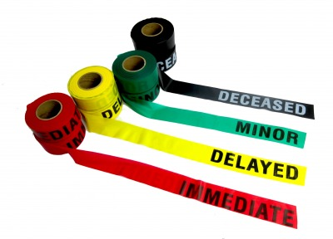
Developing the MAV-SA
Marin Assessment for Vulnerability – Single Adult
MAV-SA is an assessment that was designed from the ground up based on robust provider and client feedback
The HCC team held regular biweekly meetings over the last two years with community stakeholders at all levels of our system to develop a replacement to the VI-SPDAT
We analyzed and reviewed 10+ peer-reviewed assessments used actively across the country to inform the development of the tool
Notes:
Reviewed over 10 peer-reviewed assessments used across the country to determine the strengths and weaknesses of each.

Slide 10
Developing the MAV-SA
The Coordinated Entry Redesign group developed our Family Coordinated Entry tool, the Family Self Sufficiency Matrix, and had it formally adopted by the HPSC on February 14th, 2024
Following this implementation, work began to create our new Coordinated Entry Single Adult Assessment

Slide 11
Developing the MAV-SA - Goals
Comprehensive and Expeditious Tool
Address deficiencies seen in VI-SPDAT
Provider and lived experience feedback
Notes:
We wanted to develop an assessment that was in-depth, and could capture a wider array of vulnerabilities. At the same time we also need a tool that can be done quickly and efficiently. The Family Self Sufficiency Matrix is longer, which is more permissible given there are less families coming through our system, and more complicated backgrounds to capture.
Foremost, we wanted to fix the gaps that we saw in tehh VI-SPDAT. This included redeveloping questions we felt addressed the spirit of what we were looking for, but had traumatizing or negative language. We also wanted to add more subcategories that absent prior, such a Social and Connections to Resources.
Throughout the process we wanted to incorporate providers from our system and have their insights lead the conversations. Lived-experience must be a primary factor when developing a new assessment, so piloting and presenting to the MCLEAB was imperative.

Slide 12

Developing the MAV-SA - Guiding Material
In coordination with partners, we identified a myriad of peer-reviewed tools that have been implemented nationally to replace the VI-SPDAT
Although each assessment had their own unique benefits, we quickly determined that no single existing assessment captured all of the questions and objectives that our community was aiming to capture
Comprehensive Homeless Assessment Tool (CHAT)
DESC Vulnerability Assessment Tool
Lake County Vulnerability Assessment Crosswalk
Place Value Assessment
Wisconsin BOS Coordinated Entry Prioritization Assessment
Florida-508 Homeless Prevention Triage Tool
Notes:
We wanted to develop an assessment that was in-depth, and could capture a wider array of vulnerabilities. At the same time we also need a tool that can be done quickly and efficiently. The Family Self Sufficiency Matrix is longer, which is more permissible given there are less families coming through our system, and more complicated backgrounds to capture.
Foremost, we wanted to fix the gaps that we saw in tehh VI-SPDAT. This included redeveloping questions we felt addressed the spirit of what we were looking for, but had traumatizing or negative language. We also wanted to add more subcategories that absent prior, such a Social and Connections to Resources.
Throughout the process we wanted to incorporate providers from our system and have their insights lead the conversations. Lived-experience must be a primary factor when developing a new assessment, so piloting and presenting to the MCLEAB was imperative.

Slide 13
Developing the MAV-SA – Process Timeline
In Coordination with CE Redesign Group:
1. Review Existing Coordinated Entry Assessments (3 months)
2. Develop Initial Draft Assessment Tool Based on Provider Input (9 months)
3. Incorporate Edits from MCLEAB and Pilot Testing (3 months)
4. Finalize and Implement Assessment (Janaury 2025)
Notes:
We wanted to develop an assessment that was in-depth, and could capture a wider array of vulnerabilities. At the same time we also need a tool that can be done quickly and efficiently. The Family Self Sufficiency Matrix is longer, which is more permissible given there are less families coming through our system, and more complicated backgrounds to capture.
Foremost, we wanted to fix the gaps that we saw in tehh VI-SPDAT. This included redeveloping questions we felt addressed the spirit of what we were looking for, but had traumatizing or negative language. We also wanted to add more subcategories that absent prior, such a Social and Connections to Resources.
Throughout the process we wanted to incorporate providers from our system and have their insights lead the conversations. Lived-experience must be a primary factor when developing a new assessment, so piloting and presenting to the MCLEAB was imperative.

Slide 14

Basic Domains of MAV-SA
History of Housing
Financial
Health
Physical
Mental Health
Substance Use
Law Enforcement/Criminal Justice History
Social
Connections to Resources
Notes:
VI-SPDAT only had 4 distinct domains

Slide 15
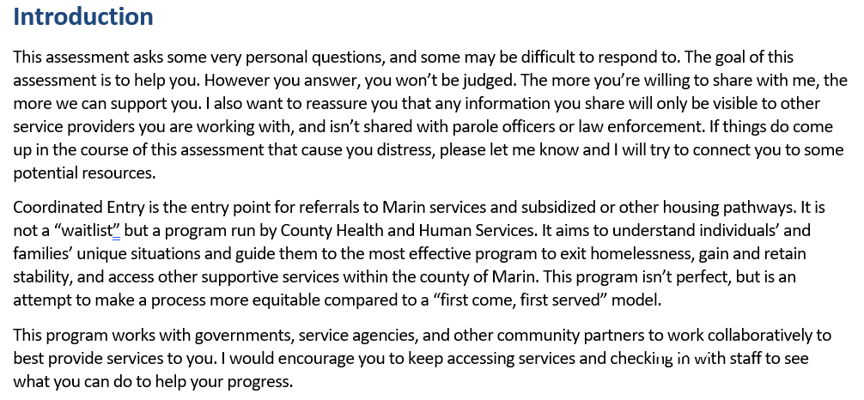
Introduction / Opening Script
Notes:
Ask a participant to read through the script

Slide 16
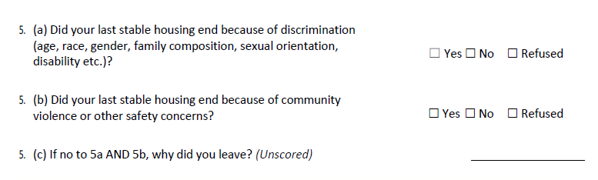
MAV-SA Example Questions - New
Opportunities for assessment proctor to interject
Notes:
We learned with the VI-SPDAT that actually accessing services and keeping up to date in the system itself is a vulnerability that was not being captured.
30. gets at geographic location being a barrier to access services, and could lead to medical emergencies going unaddressed. This was written in mind with clients that might be staying in West Marin or other places not easil reachable.
31. was designed with older adults in mind, and how online forms pose a unique and major barrier to accessing services
32. was made with Spanish speakers in mind

Slide 17
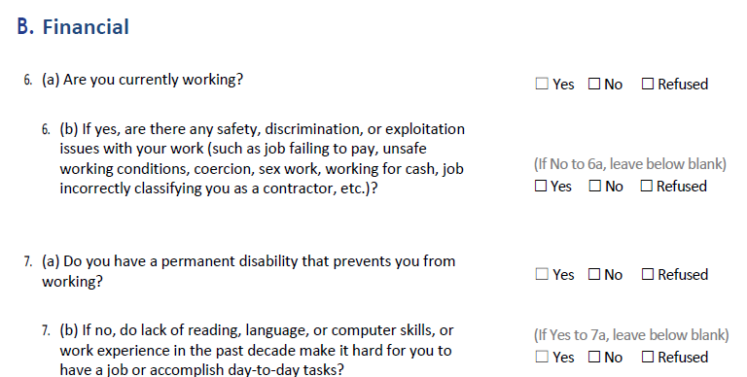
MAV-SA Example Questions - New
Cascading questions
Notes:
Cascading question give more opportunities for clients to capture vulnerability

Slide 18
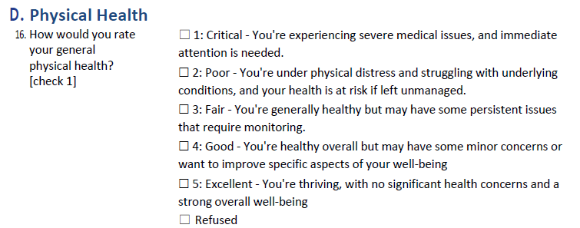
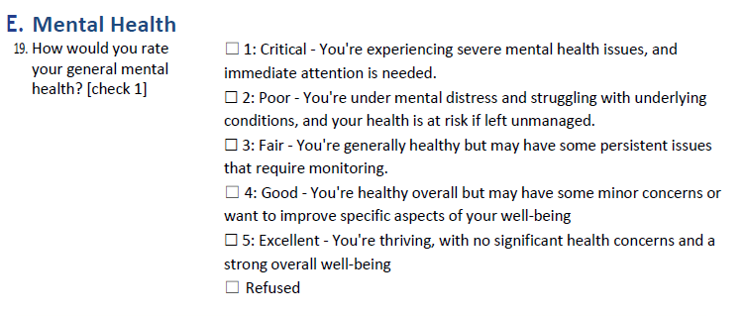
MAV-SA Example Questions - New
Qualitative questions
Notes:
We learned with the VI-SPDAT that actually accessing services and keeping up to date in the system itself is a vulnerability that was not being captured.
30. gets at geographic location being a barrier to access services, and could lead to medical emergencies going unaddressed. This was written in mind with clients that might be staying in West Marin or other places not easil reachable.
31. was designed with older adults in mind, and how online forms pose a unique and major barrier to accessing services
32. was made with Spanish speakers in mind

Slide 19
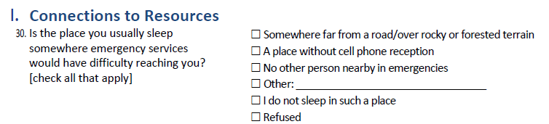
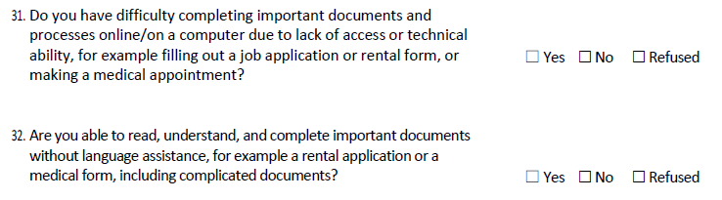
MAV-SA Example Questions - New
Service connection
Notes:
We learned with the VI-SPDAT that actually accessing services and keeping up to date in the system itself is a vulnerability that was not being captured.
30. gets at geographic location being a barrier to access services, and could lead to medical emergencies going unaddressed. This was written in mind with clients that might be staying in West Marin or other places not easil reachable.
31. was designed with older adults in mind, and how online forms pose a unique and major barrier to accessing services
32. was made with Spanish speakers in mind

Slide 20
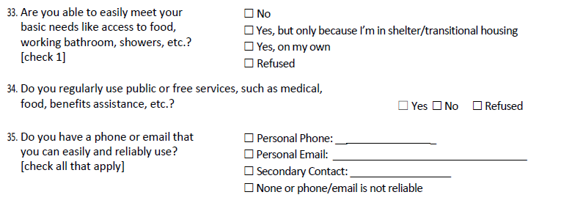
MAV-SA Example Questions - New
Service connection
Notes:
33. Similar question on the VI-SPDAT, however we added an answer specifically getting at the fact someone may only have those resources because they are in a temporary situation
34. This question was not present on the VI-SPDAT
35. Something we would ask previously,, however this is now an area where a client could get a point for not having a reliable phone/email contact

Slide 21

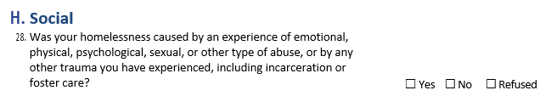
MAV-SA Example Questions – Revised from VI-SPDAT
Original VI-SPDAT Question
Revised MAV-SA Question
Notes:
33. Similar question on the VI-SPDAT, however we added an answer specifically getting at the fact someone may only have those resources because they are in a temporary situation
34. This question was not present on the VI-SPDAT
35. Something we would ask previously,, however this is now an area where a client could get a point for not having a reliable phone/email contact

Slide 22
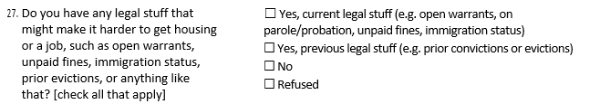
MAV-SA Example Questions – Revised from VI-SPDAT
Original VI-SPDAT Question
Revised MAV-SA Question

Slide 23
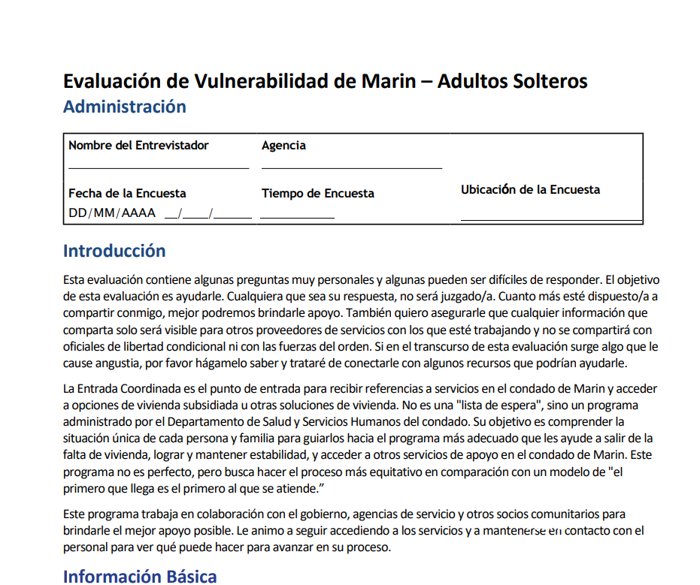

Spanish Version
Notes:
We ask that the ROI is completed at the beginning of the assessment, to provide full consent

Slide 24
Next Steps
Assess and reassess anyone and everyone with the MAV-SA
(excluding families)
New clients entering Coordinated Entry
AND
Existing clients in Coordinated Entry

Slide 25
Initial Feedback
Overall, both providers and clients have expressed that the MAV-SA is a noticeable improvement to the VI-SPDAT
The assessment feels more trauma-informed in its language, which has improved responses
Completion time is similar to the VI-SPDAT, around 15 minutes on average
Since this is the first version, our team is taking in feedback that could ultimately inform a second version
Additional questions capture a fuller scope of a client’s situation

Slide 26
Data
Notes:
508 assessments have been completed since the end of January when the assessment launched

Slide 27
Data
Notes:
508 assessments have been completed since the end of January when the assessment launched

Slide 28
Data
Notes:
508 assessments have been completed since the end of January when the assessment launched

Slide 29
Data
Notes:
508 assessments have been completed since the end of January when the assessment launched

Slide 30
Data
Notes:
508 assessments have been completed since the end of January when the assessment launched

Slide 31

Q&A

Slide 32
Contact
Nikolas Brady
Senior Program Coordinator
nikolas.brady@marincounty.gov
For any questions about the MAV-SA send to:
Coordinated Entry
ce@marincounty.gov

