Slide 1


MARIN BEHAVIORAL HEALTH AND RECOVERY SERVICES
Photo Credit: Jeff Wong
BHRS Clinical Documentation Training August 27, 2026
Presenters: Kristin Gordiejew, LMFT, Lauren Schliesmann, LMFT,
Jesse Silverstein, LCSW
Notes:
Lauren

Slide 2
Content of Training
Access to Services & Essentials in SmartCare
Diagnosis
Assessments
Problem List
Treatment Planning
Progress Notes
Resources

Slide 3
Behavioral Health & Recovery Services Clinical Documentation Training
Fraud, Waste, and Abuse
BHRS Utilization Review (UR) disallowances will be focused on Fraud, Waste and Abuse. Examples of each include:
Fraud
Deliberately claiming for services that were not provided.
Prescribing/ordering/providing unnecessary medications, treatments, labs, etc.
Claiming reimbursement for treating an individual other than the eligible individual.
Intentionally billing for an ineligible individual.
Waste
Large scale duplicative services.
Providing services/procedures/medications that are not medically necessary.
Abuse
Billing for a non-covered service.
Inappropriately allocating costs on a cost report.
Most mistakes made in clinical documentation are not fraud, waste or abuse.
If you make a mistake, it’s okay, we will work with you to correct it.
Notes:
UR reports will provide feedback for identified areas of quality improvement.

Slide 4
Behavioral Health & Recovery Services Clinical Documentation Training
Access to Specialty Mental Health Services (SMHS)
In 2022, the Access to SMHS guidelines were revised.
Access criteria for individuals has been separated from medical necessity for services.
There is no longer a list of included diagnoses to qualify for care.
Access criteria are based on level of distress/impairment, except for ages 0 through 20 which do not require impairment.
Trauma qualifies individuals who are under age 21 for SMHS.
BHRS 89 Criteria for Beneficiary Access to SMHS, medical necessity and other coverage requirements

Slide 5
Behavioral Health & Recovery Services Clinical Documentation Training
No Wrong Door for Mental Health Services
People can easily access services through both the Mental Health Plan (MHP) as well as the Managed Care Plan (MCP)
In Marin, the MHP is Marin County BHRS and the MCP is Carelon.
Beneficiaries can receive timely services without delay regardless of where they seek care.
You can provide and claim for clinically appropriate treatment in one system without worrying whether the client is currently in the “best” system for them (MHP vs MCP).
Clients can receive mental health services from both the MCP and the MHP if treatment is coordinated and non-duplicative.
BHRS 92 No Wrong Door for Mental Health Services

Slide 6
Behavioral Health & Recovery Services Clinical Documentation Training
Co-Occurring Treatment
Mental health and substance use disorder can be addressed wherever the client seeks care.
Staff can address and document both substance use and mental health concerns (if clinically appropriate and within scope of competence) without concern that acknowledging/addressing co-occurring disorders will lead to an audit finding.
Note: this change does not alter the responsibilities or the benefits packages provided by the MHP and/or the DMC/DMC-ODS Plan
BHRS 92 No Wrong Door for Mental Health Services

Slide 7
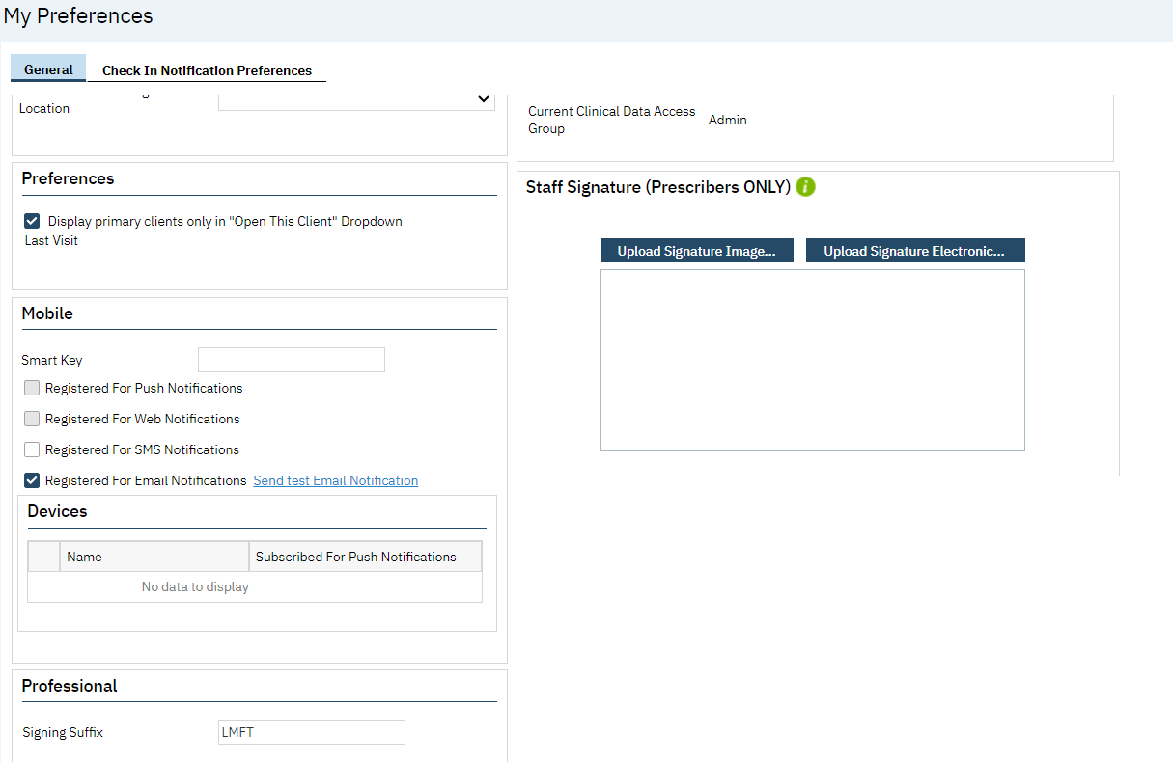
Behavioral Health & Recovery Services Clinical Documentation Training
Credentials
All staff should have their credentials present in SmartCare.
To add credentials:
Click the dropdown arrow next to your name in top right corner.
Select “My Preferences” from drop down menu.
At bottom of page find “Professional” and add your credentials in “signing suffix.”

Slide 8
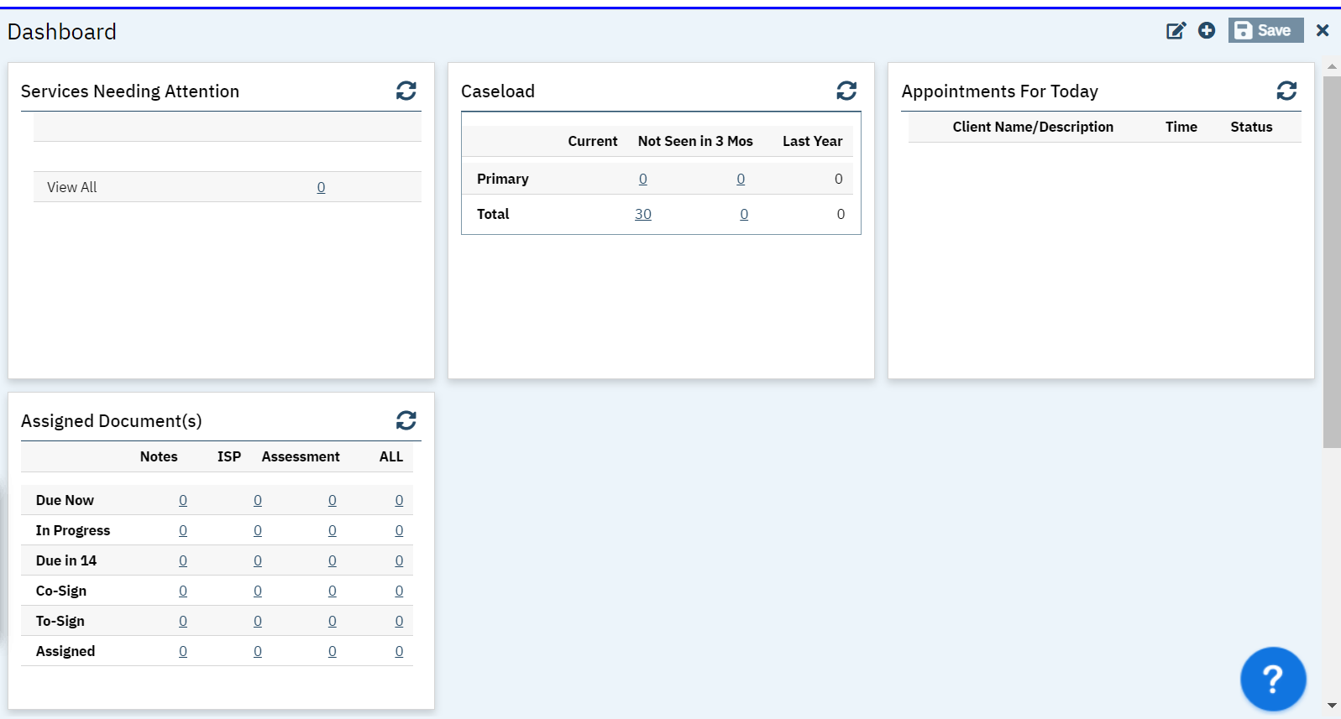
Behavioral Health & Recovery Services Clinical Documentation Training
Widgets in SmartCare
SmartCare has widgets that are multi-functional and interactive. They allow you to see and act on the information most relevant to your role and daily tasks.
The Services Needing Attention widget will flag any services that still need to be Signed in order to be finalized.
To add a widget, click the + icon on the right side of the screen.

Slide 9
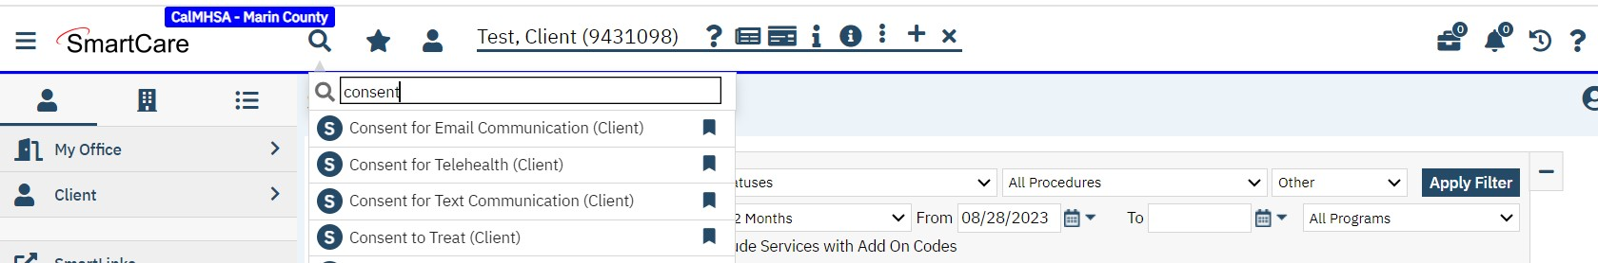
Behavioral Health & Recovery Services Clinical Documentation Training
Consents in SmartCare
All clients need consents that have wet or computerized signatures or if they have previously signed consents from the paper chart, these can be scanned into SmartCare instead of getting all new signatures. Consents should be signed prior to treatment. These include:
Consent to Treat
Notice of Privacy Practices (if completed within SmartCare, this consent is included within the Consent to Treat document)
Telehealth consent (telehealth can document verbal consent)
ROIs
https://2023.calmhsa.org/how-to-complete-a-consent/

Slide 10
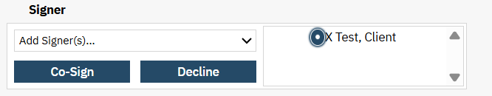
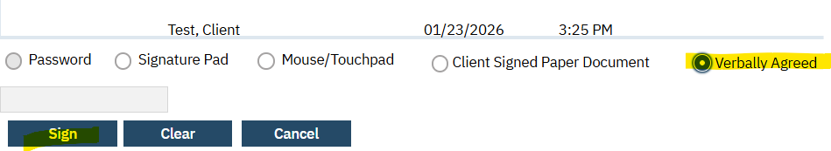
Behavioral Health & Recovery Services Clinical Documentation Training
Telehealth Consent
Telehealth Consent must be obtained prior to the initial delivery of telehealth services. All clients need to have the Telehealth Consent completed in SmartCare. This is the only consent that can be documented as the client verbally consented (all other Consents need a wet or computerized signature). Providers must discuss with the client the use of Telehealth and receive Consent prior to initiating services Clients must be informed that they have the right to access services that may be delivered via telehealth, through an in person, face-to-face visit To Document that the client verbally consented on the Telehealth Consent Form in SmartCare, the provider would sign the form first, select the client’s name next to the “signer” box (as seen below), click “Co-Sign”, then select “verbally agreed” on the signature page before clicking sign.

Slide 11
Diagnosis

Slide 12
Behavioral Health & Recovery Services Clinical Documentation Training
Treatment Prior to Establishing Diagnosis
Outpatient Services are reimbursable prior to the determination of a diagnosis.
You can provide the full range of SMHS and DMC/DMC-ODS services (except NTP/OTP) during the assessment phase of treatment
ICD-10 Z codes and Unspecified/Other Specified F codes can be used while the diagnosis is refined
BHRS 92 No Wrong Door for Mental Health Services

Slide 13
Behavioral Health & Recovery Services Clinical Documentation Training
Diagnosis
During the assessment phase, when a diagnosis has yet to be established, Z codes can be used.
ICD-10 codes Z55-Z65, “Persons with potential health hazards related to socioeconomic and psychosocial circumstances” may be used by all providers as appropriate.
ICD-10 code Z03.89, “Encounter for observation for other suspected diseases and conditions ruled out,” may be used by an LPHA or LMHP.
In cases where there is a suspected disorder that has not yet been diagnosed, LPHA/LMHPs can use Z codes found in SmartCare by using search terms such as “Other specified problems”, “Unspecified disorders”, “Other personal risk factors”, or “Health Circumstances.”
BHRS 25 Documentation Requirements for all SMHS services; BHRS 92 No Wrong Door for Mental Health Services

Slide 14
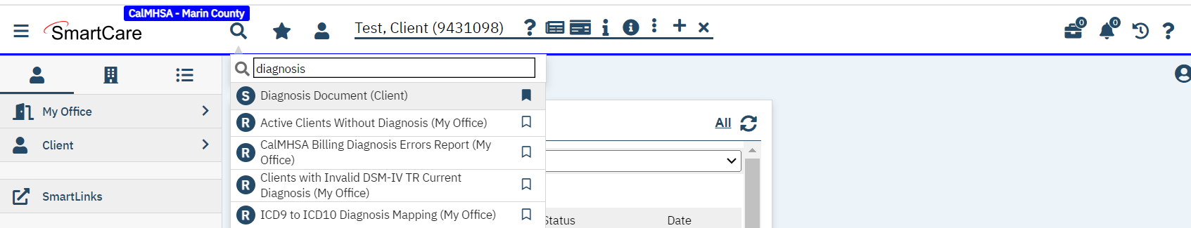
Diagnosis Document in SmartCare
Behavioral Health & Recovery Services Clinical Documentation Training
All clients need a diagnosis document for each program that they are enrolled in.
Make sure that the client's diagnosis document is affiliated with your program, otherwise you will need to create one. If you are having a billing error due to diagnosis, this may be the issue.
Check the diagnosis document for your clients to confirm it is up to date with the client's current presentation.
https://2023.calmhsa.org/how-to-add-a-diagnosis/

Slide 15
Assessment
Notes:
Lauren (normally Allison)

Slide 16
Behavioral Health & Recovery Services Clinical Documentation Training
Assessments
Specialty Mental Health Assessments contain 7 standard domains (Presenting Problem, Trauma, Behavioral Health History, Medical History, Psychosocial Factors, Strengths/Risks, and Clinical Summary)
All SMHS assessment domains are standardized across counties and providers making documentation and information exchange easier
DMC and DMC-ODS Plans will continue to use the ASAM
In addition to the CalAIM Assessment, youth also need a CANS and the PSC-35 completed.
BHRS 25 Documentation Requirements for all SMHS services

Slide 17
Behavioral Health & Recovery Services Clinical Documentation Training
SMHS Assessment Timeliness Guidelines
Initial and subsequent assessments are up to clinical discretion and are based on reasonable and generally accepted standards of practice.
Re-assessments should be done based on clinical judgement when a significant change occurs. It is good to check when the last assessment was completed and if it’s clinically appropriate to update.
It’s recommended that assessments be completed every two years.
Per updated policy, DMC-ODS assessment timelines also align with the above and assessments shall be updated as clinically appropriate.
Please make sure your clients have assessments in SmartCare either by scanning or completing a new one as they weren’t brought over from the last EHR.
BHRS 25 Documentation Requirements for all SMHS services; BHIN-23-068-Documentation-Requirements-for-SMH-DMC-and-DMC-ODS

Slide 18
Behavioral Health & Recovery Services Clinical Documentation Training
Assessment Requirements
Some assessments are distinct and do not replace a comprehensive mental health or substance use disorder assessments. Types of assessments include:
Assessments performed during delivery of crisis intervention or crisis stabilization services
Assessments performed during the delivery of Mobile Crisis Services (BHIN 23-025)
Medications for Addiction Treatment (MAT) assessments (BHIN 23-054)
Multidimensional level of care assessments required in residential treatment programs
BHIN 23-068 Documentation Requirements for SMH DMC and DMC-ODS Services.pdf

Slide 19
Problem list
Notes:
Jesse (normally Allison)

Slide 20
Behavioral Health & Recovery Services Clinical Documentation Training
Problem List
Problem List codes consist of:
Mental Health and Substance Use Disorder Diagnoses (Mental, Behavioral, and Neurodevelopmental Disorders)
  ICD-10 F Codes
Factors Influencing Health Status and Contact with Health Services
  ICD-10 Z Codes
Physical Health Codes
Providers should add or end date problems from the problem list when there is a relevant
change to a beneficiary’s condition. There is no set timeline for when to update the Problem
List, rather it should be monitored to make sure it reflects the client’s current presentation.
BHRS 25 Documentation Requirements for all SMHS services

Slide 21
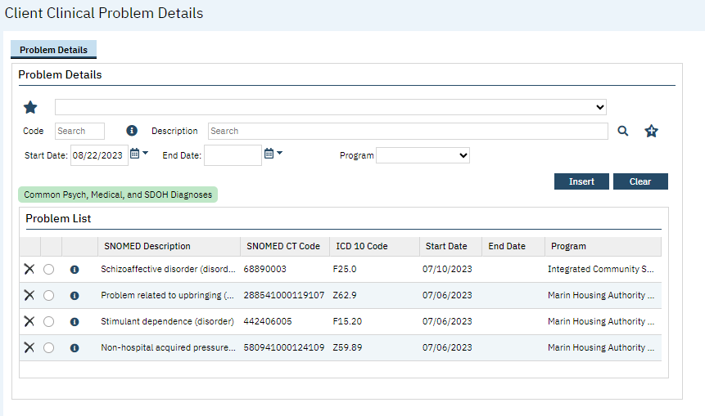
Behavioral Health & Recovery Services Clinical Documentation Training
Problem List in SmartCare
The CalMHSA website has step by step guides on the Problem List including:
How to Add a Problem to the Problem List
How to Remove a Problem That’s Been Resolved
How to Add Favorites to the Problem List Screen
How to Filter/Sort a Client’s Problem List

Slide 22
Treatment Planning
Notes:
Jesse (normally Allison)

Slide 23
Behavioral Health & Recovery Services Clinical Documentation Training
Treatment Plan Requirements
Most service types do not require a treatment plan
Targeted Case Management (TCM) and Peer Support Services require a simplified Care Plan documented narratively in a progress note
Services for which treatment plans are still required are:
  Therapeutic Behavioral Services (TBS)
  Intensive Home-Based Services (IHBS)
  Intensive Care Coordination (ICC)
  Therapeutic Foster Care (TFC)
  Short-Term Residential Therapeutic Programs (STRTPs)
  Narcotic Treatment Programs (NTPs)
BHRS 25 Documentation Requirements for all SMHS services

Slide 24
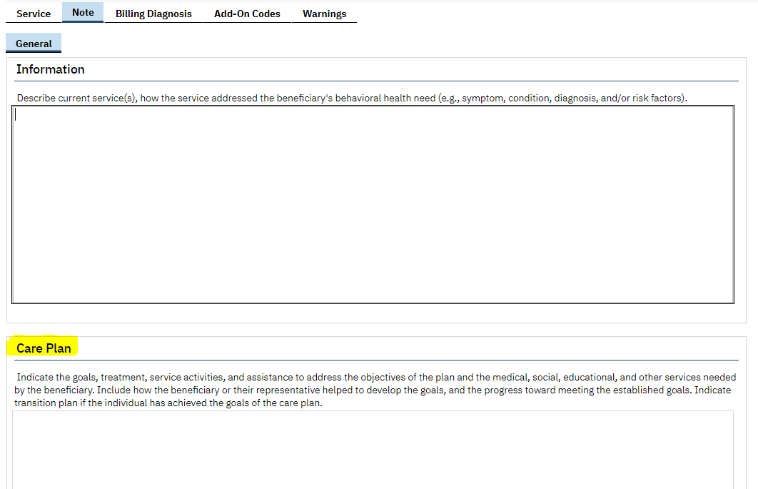
Behavioral Health & Recovery Services Clinical Documentation Training
Treatment Plan Requirements
Targeted Case Management (TCM) requires a Care Plan (entered in the “Care Plan” box in the progress note template) to meet federal regulations for SMHS. Not required for DMC-ODS.
If you provide TCM services to a client, you need a Care Plan attached to your progress note for SMHS. (This pulls through to future notes and should be updated as relevant.)
This Care Plan does not require a client signature.

Slide 25
Behavioral Health & Recovery Services Clinical Documentation Training
Treatment Plan Requirements
Targeted Case Management (TCM) Care Plans should include:
The goals, treatment, service activities, and assistance to address the negotiated objectives of the plan and the medical, social, educational and other services needed by the member.
Activities such as ensuring the active participation of the member, and working with the member (or the member’s authorized health care decision maker) and others to develop those goals.
A course of action to respond to the assessed needs of the member.
Development of a transition plan when a member has achieved the goals of the care plan.

Slide 26
Behavioral Health & Recovery Services Clinical Documentation Training
Treatment Plan Requirements
Peer Support Services by Certified Peers
Only completed by certified peers.
Plan of Care should be documented within the progress notes (in the Care Plan box).
Needs to be approved by any treating provider who can render reimbursable Medi-Cal Services.
Certified peers should then only use billing codes:
  For individual services: Self Help/Peer Service
  For group services: Behavioral Health Prevention Education Service

Slide 27
Progress notes
Notes:
Kristin

Slide 28
Behavioral Health & Recovery Services Clinical Documentation Training
Progress Notes
Each progress note should provide sufficient detail to support the service code.
Each note shall include:
Type of service rendered (procedure code)
Duration of the service, including separate travel and documentation time. Late notes may now include documentation time. Documentation time is no longer limited, but note should justify documentation time
Location of the member at the time of receiving the service.
A narrative describing the service, including interventions that addressed the member’s behavioral health need.
Next steps including, but not limited to, planned action steps by the provider or by the member, collaboration with the member, collaboration with other providers, and any update to the problem list as appropriate.
Progress note content only requires an “I” and a “P” section – Intervention and Plan. Please include what specific Interventions you provided to the client and a detailed Plan for next steps going forward (homework, issues of focus for next session - not just next scheduled session date/time).
Remember the Golden Thread!

Slide 29
Behavioral Health & Recovery Services Clinical Documentation Training
Group Progress Notes
When a group service is rendered, a list of participants is required to be documented and maintained by the plan or provider.
Should more than one provider render a groups services, one progress note may be completed for a group session and signed by one provider. The progress note should clearly document the specific involvement and the specific amount of time of involvement of each provider of the group activity, including documentation time. All other progress note requirements listed previously should also be met.
A brief description of the member’s response to the service.
  Group Documentation
  Group Services: Video Documentation Guides
  How to Create a New Group
  How to Schedule Groups
  How to Add/Remove Clients or Staff from a Group Service
  How to Write a Group Progress Note

Slide 30
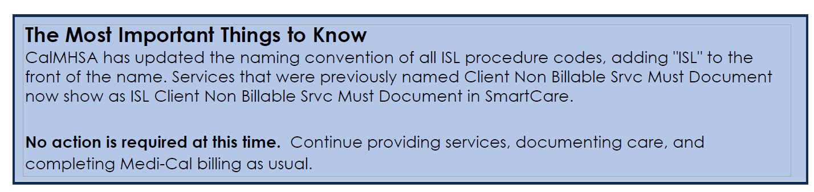
Behavioral Health & Recovery Services Clinical Documentation Training
Individual Service Level (ISL) Notes
Beginning January 1, 2027, California counties will begin reporting certain non-Medi-Cal behavioral health services and expenses provided to individuals as part of Behavioral Health Services Act (BHSA) requirements. The goal is to better capture the full range of behavioral health services already being provided—not to change how care is delivered.

Slide 31
Behavioral Health & Recovery Services Clinical Documentation Training
Progress Note Timeliness
Notes for crisis service shall be completed within 24 hours, all other service notes should be completed and finalized within 3 business days.
Notes that require co-signature shall be completed within 3 business days in draft form and should be finalized as soon as possible after co-signature.
Late notes need to include notation of “Late Note” in the body of the note. Late notes should still record documentation time.
BHRS 25 Documentation Requirements for all SMHS services

Slide 32
Collateral Services
Behavioral Health & Recovery Services Clinical Documentation Training
Collateral services can still be billed under Payment Reform; there is simply no longer a distinct service code called “collateral”*
(Beginning in FY 25/26- Collateral can be billed as standalone for these service descriptions only- Caregiver training in strategies and techniques to facilitate member’s functional performance in the home or community or Caregiver training in behavior management for caregiver of members with mental diagnosis or Caregiver training in behavior management for caregiver of member with mental diagnosis (without the member present) by MD/OD, PA, NP, Psychologist and LPHAs)
Collateral can be a component of many types of services including, but not limited to: Assessment, Rehabilitation, Plan Development, Peer Support Services, Targeted Case Management, TFC and Crisis Intervention.
When documenting services provided to a collateral contact, providers should select the service code that most closely fits the service provided and it should be clear in the progress note that the service was provided to a collateral contact.
Notes:
Jesse

Slide 33
Progress Note Examples
Behavioral Health & Recovery Services Clinical Documentation Training
Targeted Case Management
This staff contacted the local county community center to inquire about programs that could assist with addressing the client’s mental health needs. After discussing the types of programs that could be beneficial for the client, the community center staff confirmed that the center’s wellness group and social support activities would be appropriate. This staff requested information about next steps for the client to enroll and participate in upcoming sessions.
This staff will contact the client to explain the available resources, assist with the enrollment process, and prepare the client for potential participation in these programs.
Source: CALMHSA, SMHS Clinical Documentation Guide - Appendix V, https://www.calmhsa.org/wp-content/uploads/2025/04/SMHS-Clinical-Documentation-Guide-4.25.2025.pdf

Slide 34
Progress Note Example
Behavioral Health & Recovery Services Clinical Documentation Training
Psychosocial Rehabilitation
This provider met with the client today to provide psychosocial rehab services based on concerns related to functional impairments that include inability to maintain employment given intense feelings of anxiety. I focused on providing psychoeducation and building skills related to emotion regulation and managing chronic stress in order to increase client’s functioning in social and occupational settings-specifically we discussed mindfulness techniques and reframing stressful situations.
When we meet next week, we will discuss the client’s perspective on how helpful these coping skills have been and will continue to explore strategies that can assist the client with effectively managing symptoms of anxiety.
Source: CALMHSA, SMHS Clinical Documentation Guide - Appendix V, https://www.calmhsa.org/wp-content/uploads/2025/04/SMHS-Clinical-Documentation-Guide-4.25.2025.pdf

Slide 35
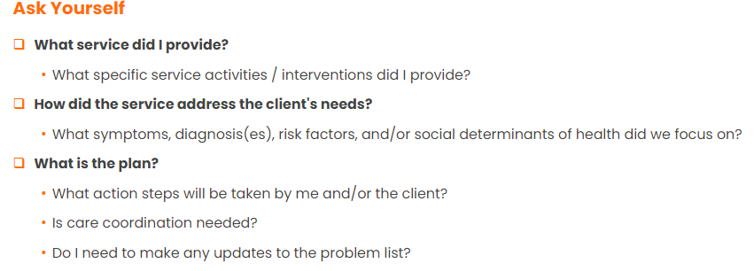
Behavioral Health & Recovery Services Clinical Documentation Training
When writing progress notes:

Slide 36
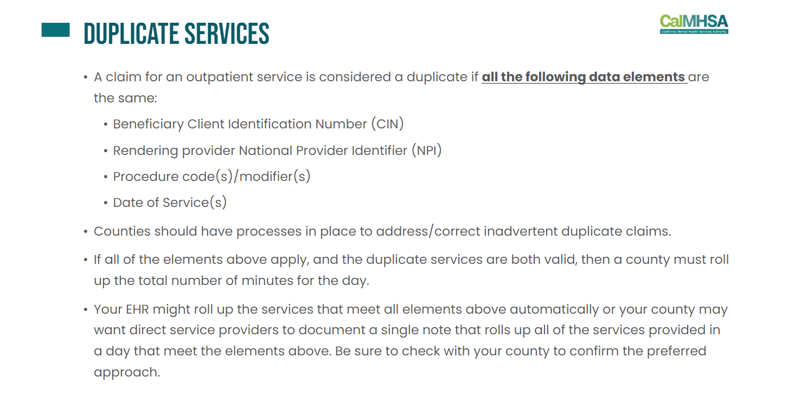
Duplicate Service Errors
Behavioral Health & Recovery Services Clinical Documentation Training
Issue: Duplicate Service Errors are resulting from staff entering two notes on the same day for the same client, same provider, same service,
but different location, resulting in denials (i.e. location of am service is in person and second service in pm is on phone). In these types of
instances, the second service is getting denied.
Solution: The staff should write one note that includes both services provided on same day, same service for same client and choose the
location code that was used the majority of time (51%). Staff can document in the note the actual location of the second service. This will
allow both services to be billed successfully.

Slide 37
Service Errors
Behavioral Health & Recovery Services Clinical Documentation Training
On an ongoing basis, QM sends out SmartCare service error reports to programs. These are services in SmartCare that have errors that prevent them from being billed.
Most common errors are Service needs Diagnosis, unsigned note, or no active license in SmartCare.
Services needing Diagnosis Error need to have either a diagnosis document for your program completed that includes the date of service or ICD 10 code needs to be included: https://2023.calmhsa.org/how-to-add-an-icd-10-code-to-a-service-before-the-clinician-completes-the-assessment-and-diagnosis/
  Diagnosis Entry
  How to Document a Diagnosis for a Client
  How to Save a Favorite Diagnosis
  How to Pull a Diagnosis Forward from Another Program
Needs signed note Error means staff need to sign note to finalize it so it can bill.
No Active License in SmartCare- please work with BHRS credentialing to add provider’s active license to their SmartCare account. Email BHRSCredentialingPub@marincounty.gov
Please make sure you have have the Services Needing Attention Widget so you are aware of any errors and can fix them in a timely manner: https://2023.calmhsa.org/services-needing-attention-widget/

Slide 38
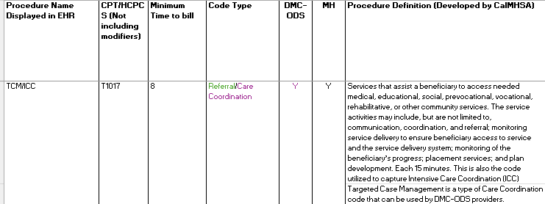
Minimum Time to Bill
Behavioral Health & Recovery Services Clinical Documentation Training
With payment reform, procedures must meet minimum time threshold in older to bill. Usually this is at least 51% of the time billed by the CPT code. Example, TCM is billed in 15 minute units in the background of SmartCare so a TCM service must be at least 8 (51% of 15) minutes in order to bill. A 7 minute TCM service will not get billed.
There is an excel guide of procedure codes and minimum times posted here:
https://www.marinbhrs.org/providers/mental-health-providers/clinical-documentation-guide

Slide 39
Resources & CalAIM Payment Reform
Notes:
Jesse

Slide 40
CalAIM Payment Reform
Behavioral Health & Recovery Services Clinical Documentation Training
Payment reform began on July 1, 2023.
This transitions counties from cost-based reimbursement to fee-for-service reimbursement.
Counties are now paid for services rendered instead of the cost of providing services.
Counties must utilize CPT codes to improve reporting and support data-driven decision making.
SmartCare will automatically manage the changes to coding brought about by payment reform. This means most of the changes are happening in the background of the Electronic Health Record.

Slide 41
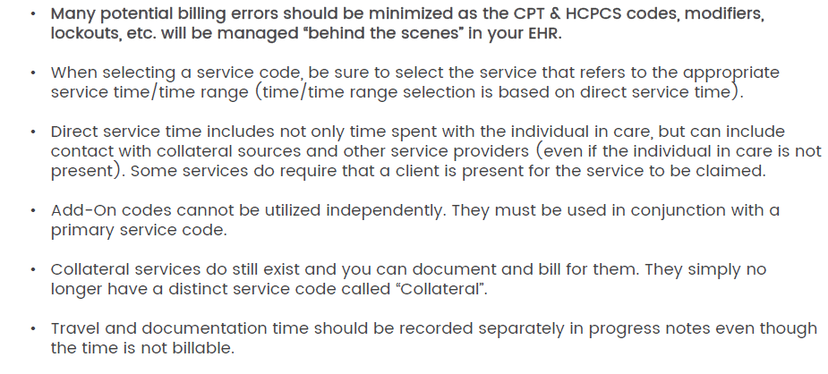
CalAIM Payment Reform
Behavioral Health & Recovery Services Clinical Documentation Training
Payment Reform - California Mental Health Services Authority (calmhsa.org)Service Code Definitions - 2023 CalMHSA

Slide 42
Lockout Guide
Behavioral Health & Recovery Services Clinical Documentation Training
Facilities with full lockouts/restrictions SMHS
Institutions for Mental Disease (IMD)
Mental Health Rehabilitation Center (MHRC)
Skilled Nursing Facilities (SNF) with Special Treatment Programs (STP)
Psychiatric Healing Facilities (PHF)
Prison/Correctional Facilities - exceptions for Justice-Involved Reentry clients and for dependent minors
State Hospitals
Examples include, but not limited to: Canyon Manor Residential, Creekside Santa Rosa, Crestwood Modesto, Crestwood Stockton, Sequoia Treatment Center, Crestwood Healing Center Santa Rosa, Marin County Jail, Napa State Hospital
Facilities with partial lockouts/restrictions SMHS
Crisis Stabilization Unit - Case Management allowed after admission. Other services can be provided day of admission but only prior to time of admission.
Acute Psychiatric Inpatient Units - Case Management allowed only related to discharge planning. (MarinHealth, SFGH, St Francis Hospital, John Muir Behavioral Health Center, Aurora Santa Rosa)
Crisis Residential Facilities – Case Management and Certified Peer Support Services allowed (Casa Rene)
Adult Residential Treatment Facilities (920 Grand Ave)-MH services are locked out when a provider of both MH and ART allocates the same staff's time under the two cost centers of Mental Health Services and Adult Residential Treatment Services for the same period of time. Per 9 CCR § 1840.362
Facilities without any lockouts/restrictions SMHS
Transitional Residential Facilities Medical Skilled Nursing Facilities without Special Treatment Program (The Gardens, Northgate Post-Acute Care, The Oaks Petaluma, Pineridge Healthcare Center)
Residential Care Facilities aka Board and Care (Crestwood Our House Vallejo, Davis Guest Home, Psynergy, St. Michael’s, Willow Glen
This is an overview of common lockout situations and facilities for BHRS clients. More details can be found on Page 55 of the
Clinical Documentation Guide: Clinical Documentation Guide | Marin BHRS

Slide 43
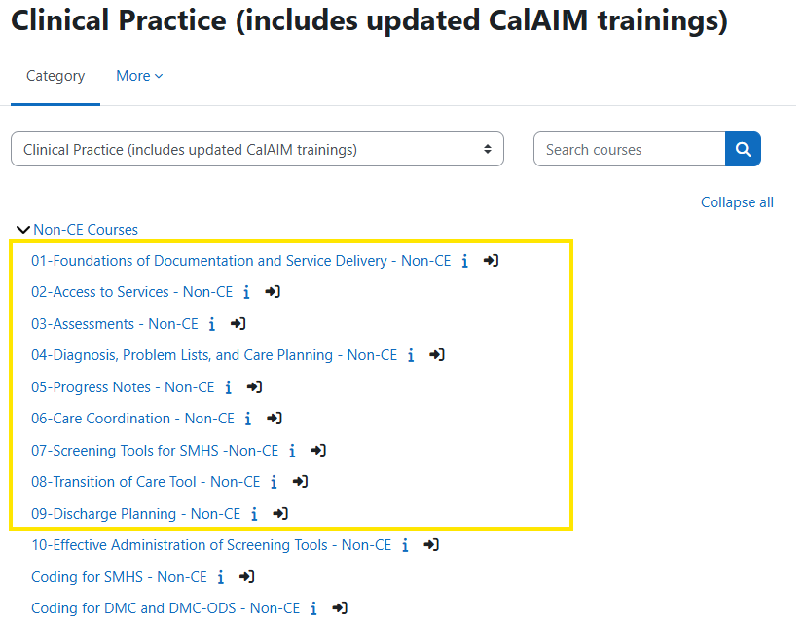
Behavioral Health & Recovery Services
CalMHSA required trainings
Go to: moodle.calmhsalearns.org/
Courses 1-9 are mandatory for all direct staff

Slide 44
Behavioral Health & Recovery Services Clinical Documentation Training
Resources
CalMHSA has created step-by-step trainings with detailed information regarding all the CalAIM changes and SmartCare user functionality.
CalMHSA CalAIM and SmartCare EHR trainings are required for all staff: moodle.calmhsalearns.org/
CalMHSA documentation guides: California Mental Health Services Authority | Documentation Guides (calmhsa.org)
CalMHSA SmartCare user guides and training videos, live chat for support: https://2023.CalMHSA.org
Chat Bot: CalMHSA Smartcare AI chatbot for questions
Clinical Documentation Guide | Marin BHRS
Marin County QM Team / Email BHRSQM@marincounty.gov

