Slide 1

2026 Point-In-Time Count (PIT) Overview
Homelessness and Coordinated Care (HCC) Division
Homeless Policy Steering Committee (HPSC)
September 9th, 2026

Slide 2
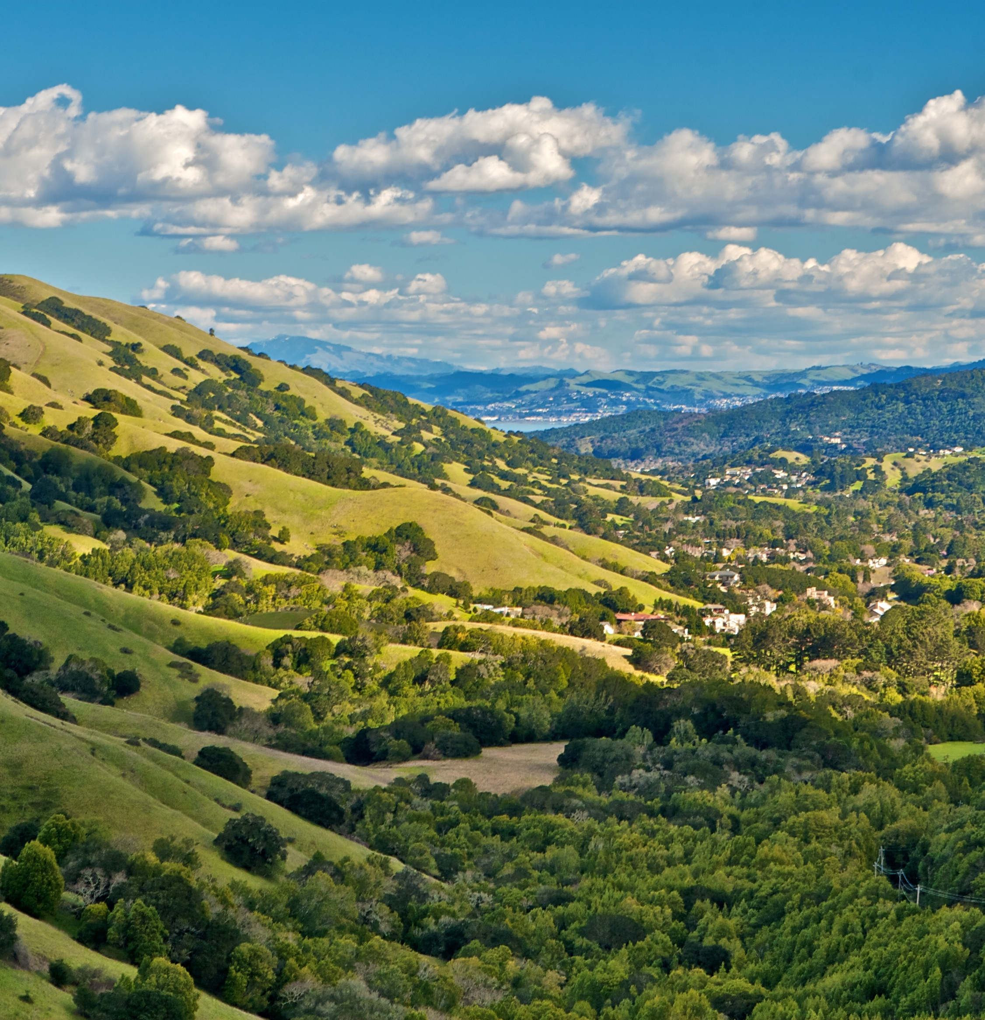
AGENDA
General Overview
Special Populations
Survey Results
Geography

Slide 3
Disability Accommodations
DISABILITY ACCOMMODATIONS
The County of Marin is committed to ensuring all its programs, services, activities, and facilities are accessible to people with disabilities. To learn more about accessibility and the County of Marin, please visit the Disability Access Program webpage, or contact the ADA Coordinator at (415) 473 -4381, or at DisabilityAccess@MarinCounty.gov. Documents in alternative formats are available, upon request.

Slide 4
Total Experiencing Homelessness & Demographics
General Overview

Slide 5
What is the Point-in-Time (PIT) Count?
GENERAL OVERVIEW

Slide 6
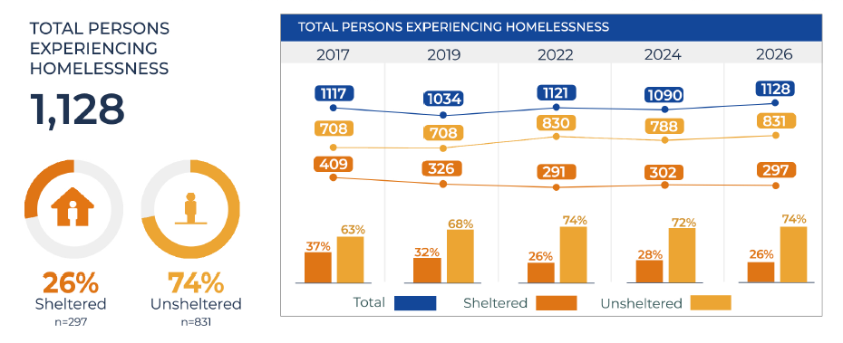
Total Persons Experiencing Homelessness
GENERAL OVERVIEW
General Overview
Special Populations
Survey Results
Geography
Notes:
The 2026 Point-in-Time Count shows mixed results and a clear call to action.
Marin counted 1,128 people experiencing homelessness, a modest increase from 1,090 in 2024.
The majority of people counted were unsheltered: 831 people, or 74%, compared with 297 sheltered, or 26%.

Slide 7
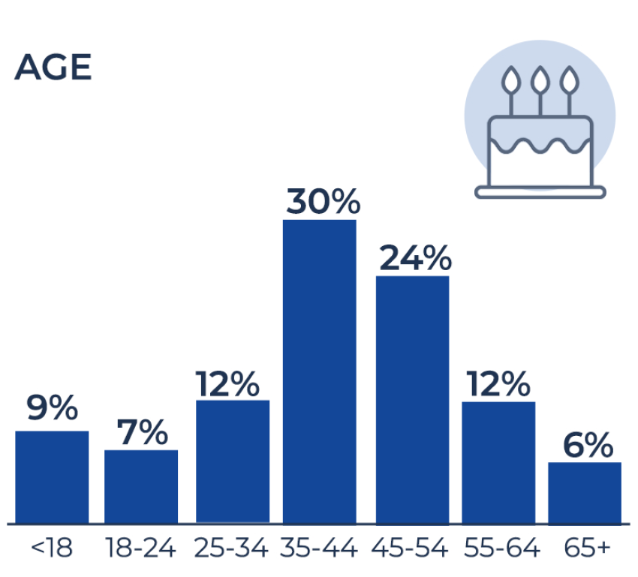
GENERAL OVERVIEW
General Overview
Special Populations
Survey Results
Geography
Notes:
HUD categories for age (we have a 60+ special population for Marin)
9% under 18, predominantly in families as opposed to unaccompanied minors
7% in the TAY age range
30% 35-44, our highest age population, 24% for 45-54 our second highest, and 12% for 25-34
55+ were 18% (6% 65+ and 12% 55-64)

Slide 8
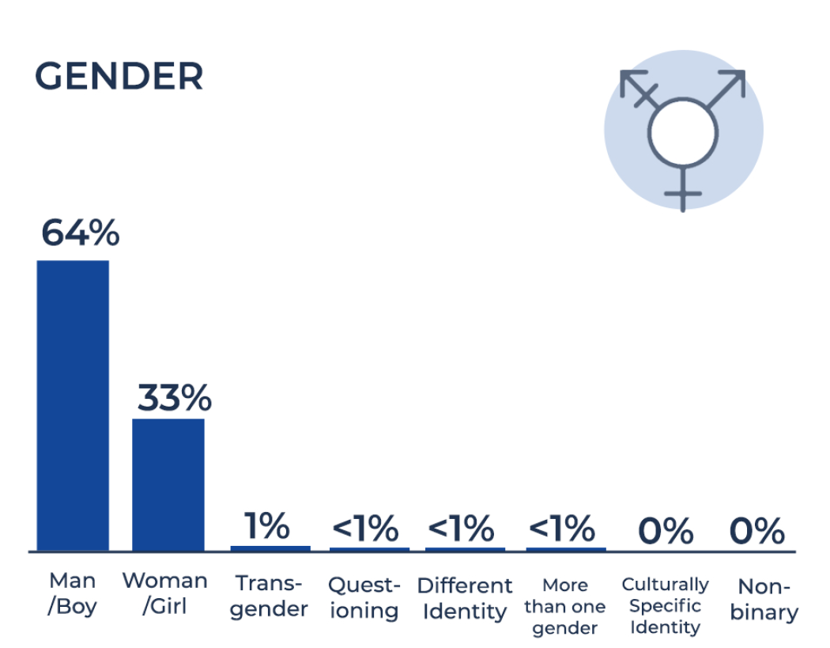
GENERAL OVERVIEW
General Overview
Special Populations
Survey Results
Geography

Slide 9
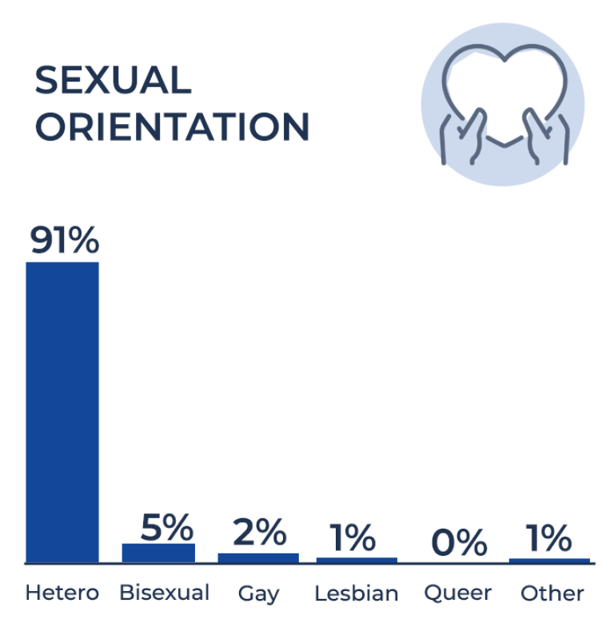
GENERAL OVERVIEW
General Overview
Special Populations
Survey Results
Geography
Notes:
91% identified as heterosexual
5 bisexual, 2 gay, 1 lesbian, (8% in total)

Slide 10
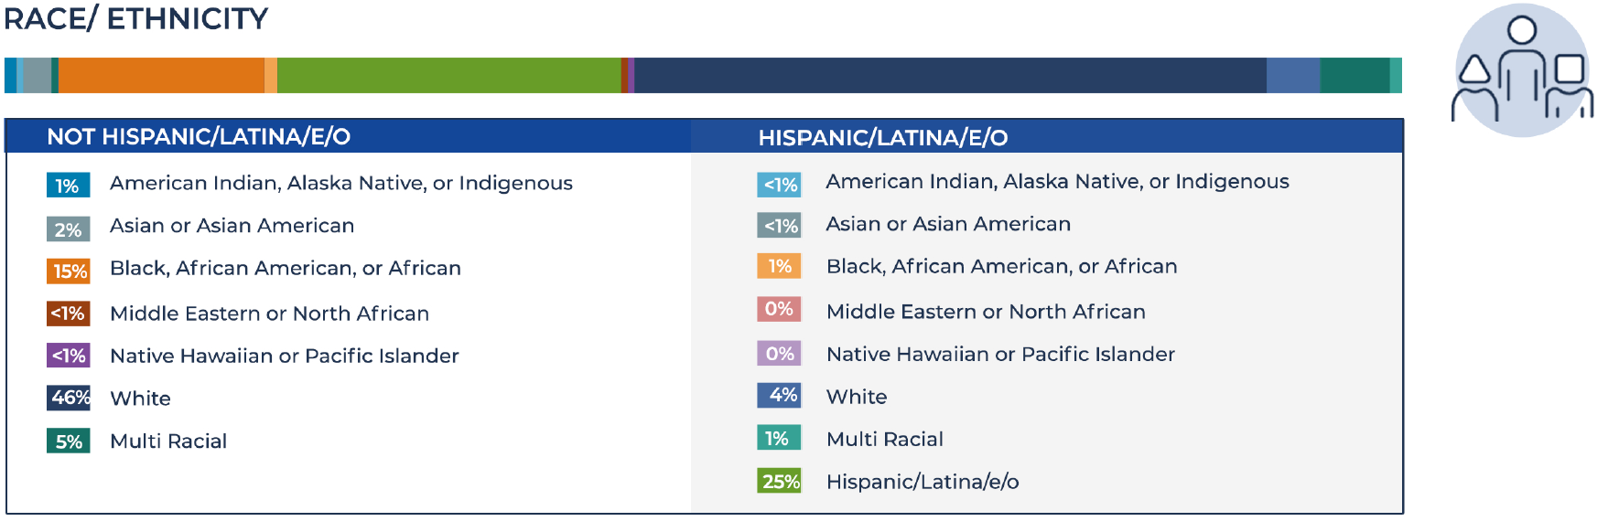
GENERAL OVERVIEW
General Overview
Special Populations
Survey Results
Geography
Notes:
46% identified as white (non Hispanic)
15% identified as Black/African American (non-Hispanic)
25% identified as just Hispanic/Latino

Slide 11
Chronic, Veterans, Families, Youth, and Older Adults
Special Populations

Slide 12

U.S. Department of Housing and Urban Development (HUD) Definition
SPECIAL POPULATIONS
Chronic Homelessness
An individual experiencing homelessness with a disability who:
Lives in a place not meant for human habitation, a safe-haven, or in an emergency shelter, AND
Has been homeless and living as described for at least 12 months OR on at least 4 separate occasions in the last 3 years totaling 12 months
General Overview
Special Populations
Survey Results
Geography

Slide 13
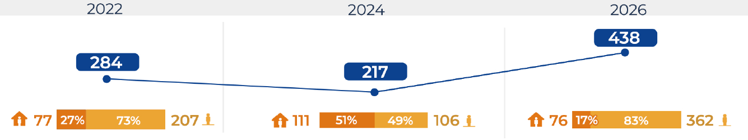
Chronic Homelessness
SPECIAL POPULATIONS
It is estimated that 438 individuals were experiencing chronic homelessness in January 2026
There was an increase in the percentage of those experiencing chronic homelessness between 2024 and 2026, rising from 20% in 2024 to 39% in 2026.
General Overview
Special Populations
Survey Results
Geography

Slide 14
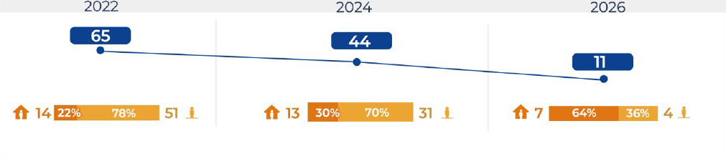
Veteran Homelessness
SPECIAL POPULATIONS
Veteran homelessness declined from 44 veterans in 2024 to 11 in 2026, a 75% decrease.
The sheltered share of veterans increased, from 30% sheltered in 2024 to 64% sheltered in 2026.
General Overview
Special Populations
Survey Results
Geography
Notes:
Veteran homelessness declined significantly, from 44 veterans in 2024 to 11 in 2026, a 75% decrease. The sheltered share of veterans also increased, from 30% sheltered in 2024 to 64% sheltered in 2026.
This is one of the strongest positive findings in the PIT. It shows that focused, coordinated, strategies on a specific population can work when outreach, housing resources, case management, and partner accountability are aligned.

Slide 15
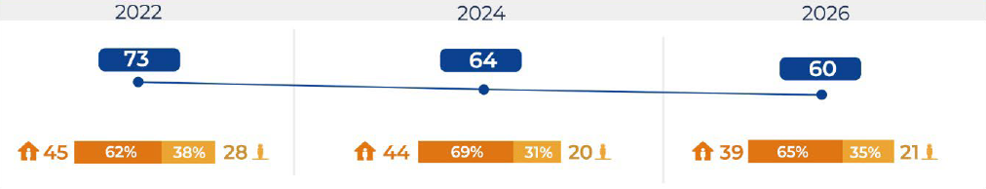
Family Homelessness
SPECIAL POPULATIONS
Families experiencing homelessness decreased from 64 families in 2024 to 60 in 2026.
General Overview
Special Populations
Survey Results
Geography

Slide 16
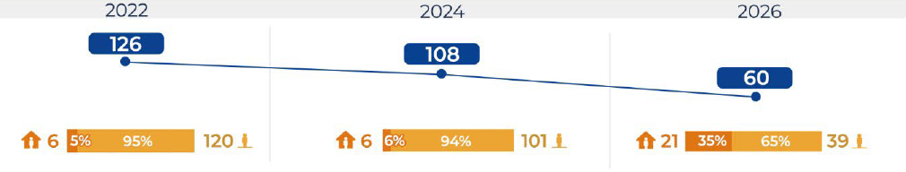
Youth and Young Adult (YYA) Homelessness
SPECIAL POPULATIONS
Youth and Young Adults experiencing homelessness decreased from 108 in 2024 to 60 in 2026.
The share who were sheltered also increased from 6% sheltered in 2024 to 35% sheltered in 2026.
General Overview
Special Populations
Survey Results
Geography

Slide 17
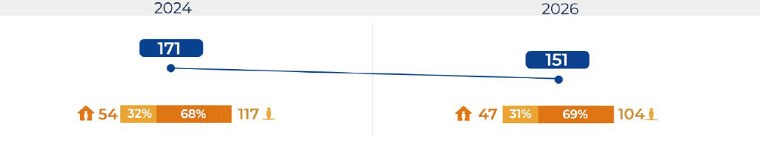
Older Adult Homelessness
SPECIAL POPULATIONS
Older adults age 60+ decreased from 171 in 2024 to 151 in 2026, a 12% decrease.
Of those older adults, 69% were unsheltered and 31% were sheltered.
General Overview
Special Populations
Survey Results
Geography

Slide 18
Additional Responses from the PIT Survey
Survey Results

Slide 19
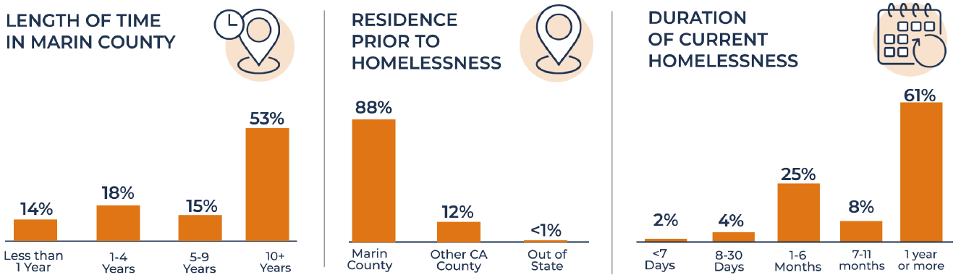
Length in Marin, Prior Residence, & Duration Homeless
SURVEY RESULTS
General Overview
Special Populations
Survey Results
Geography
Notes:
The PIT shows that 88% of survey respondents were living in Marin County prior to homelessness.
This reinforces that homelessness in Marin is overwhelmingly local. These are largely people who were already part of our community before they lost housing.
The PIT shows that 61% of respondents had been homeless for one year or more. That aligns with the increase in chronic homelessness and underscores the urgency of reducing the amount of time people remain homeless.
A major local factor is the voucher shortfall, which has slowed housing placements even for people who are already eligible and working with service providers.
The increase shows that need is outpacing available exits, especially vouchers and deeply affordable housing. Many chronically homeless individuals are already engaged with providers and on a housing pathway but cannot complete the move into permanent housing until vouchers or other housing resources become available.

Slide 20
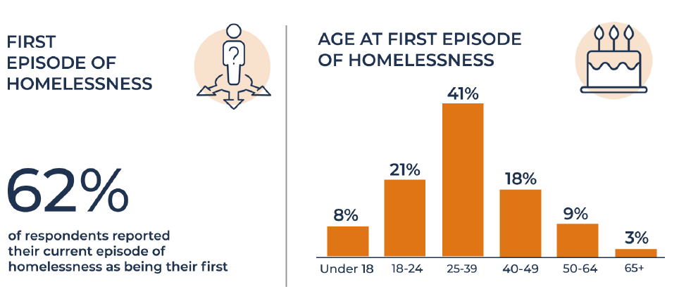
First-Time Homeless & Age At Entry
SURVEY RESULTS
General Overview
Special Populations
Survey Results
Geography
Notes:
The PIT shows that 62% of respondents reported their current episode of homelessness as their first.
That makes prevention and early intervention especially important. If we can reach people earlier with financial assistance, housing problem-solving, legal supports, and service connections, we have a better chance of preventing long-term homelessness.

Slide 21
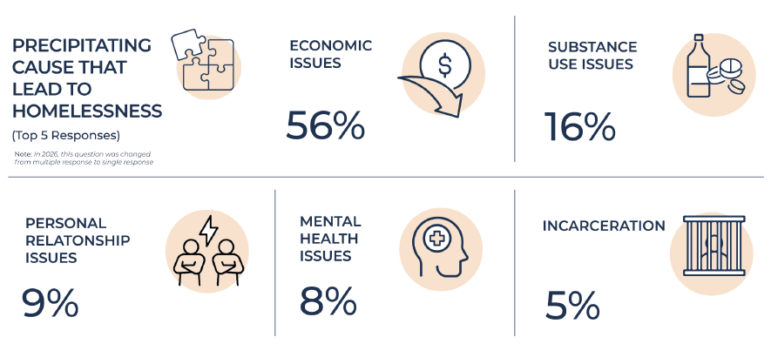
Precipitating Cause That Led to Homelessness
SURVEY RESULTS
General Overview
Special Populations
Survey Results
Geography
Notes:
The PIT identifies economic issues as the leading precipitating cause of homelessness, reported by 56% of respondents. Substance use issues were reported by 16%, personal relationship issues by 9%, mental health issues by 8%, and incarceration by 5%.
The data reinforces that homelessness is fundamentally tied to housing affordability, income instability, and economic pressure. Behavioral health and substance use needs are real and important service needs, but the leading reported cause was economic.

Slide 22
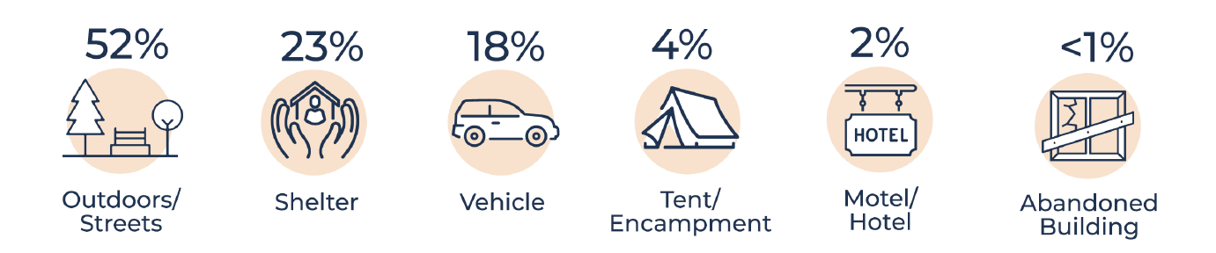
Primary Sleeping Accommodation
SURVEY RESULTS
General Overview
Special Populations
Survey Results
Geography

Slide 23
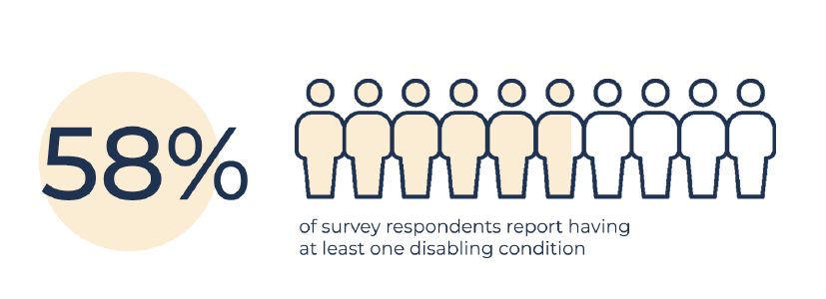
Disabling Conditions
SURVEY RESULTS
General Overview
Special Populations
Survey Results
Geography
Notes:
The PIT shows that 58% of survey respondents reported at least one disabling condition.
It also shows high rates of drug or alcohol use, psychiatric or emotional conditions, PTSD, physical disability, and chronic health conditions.
This supports Marin’s Coordinated Care response: housing, outreach, behavioral health, recovery supports, health care, and ongoing case management working together.

Slide 24
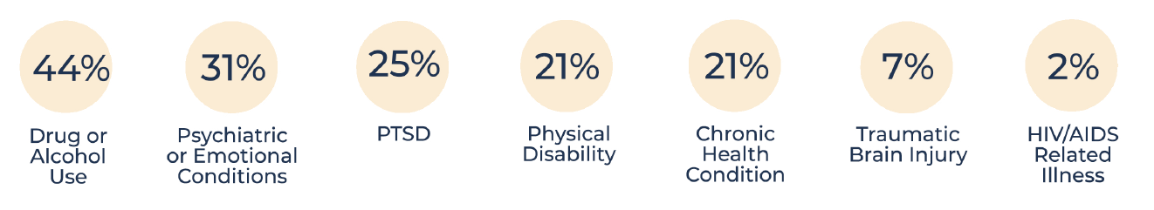
Disabling Conditions
SURVEY RESULTS
General Overview
Special Populations
Survey Results
Geography
Notes:
The PIT shows that 58% of survey respondents reported at least one disabling condition.
It also shows high rates of drug or alcohol use, psychiatric or emotional conditions, PTSD, physical disability, and chronic health conditions.
This supports Marin’s Coordinated Care response: housing, outreach, behavioral health, recovery supports, health care, and ongoing case management working together.

Slide 25
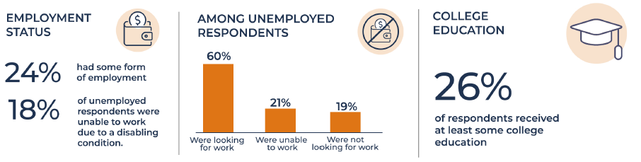
Employment and Education
SURVEY RESULTS
General Overview
Special Populations
Survey Results
Geography
Notes:
The PIT shows that 58% of survey respondents reported at least one disabling condition.
It also shows high rates of drug or alcohol use, psychiatric or emotional conditions, PTSD, physical disability, and chronic health conditions.
This supports Marin’s Coordinated Care response: housing, outreach, behavioral health, recovery supports, health care, and ongoing case management working together.

Slide 26
Population by Jurisdiction
Geography

Slide 27
GEOGRAPHY
Population By Geographic Area
Geographic Area | 2024 | 2026 | Change | %
North Marin | 316 | 285 | −31 | −9.8%
Central Marin | 387 | 435 | 48 | 12.40%
Southern Marin | 185 | 76 | −109 | −58.9%
West Marin | 120 | 251 | 131 | 109.20%
Other | 82 | 81 | −1 | −1.2%
Marin County Total | 1,090 | 1,128 | 38 | 3.50%
Refer to Executive Summary and Full PIT Report for all cities, towns, and jurisdictions
General Overview
Special Populations
Survey Results
Geography
Notes:
West Marin saw a significant increase, from 120 people in 2024 to 251 in 2026. That should be interpreted carefully. It likely reflects both real need and improved identification through stronger local knowledge, rural outreach, and count coverage.

Slide 28
GEOGRAPHY
Notable Changes – Population By Jurisdiction
Jurisdiction | 2024 | 2026 | Change | %
Other Unincorporated West Marin | 20 | 138 | 118 | 590.00%
Corte Madera | 3 | 13 | 10 | 333.30%
San Rafael | 326 | 385 | 59 | 18.10%
Unincorporated North Marin | 71 | 50 | −21 | −29.6%
Fairfax | 17 | 5 | −12 | −70.6%
Marin City | 62 | 45 | −17 | −27.4%
Unincorporated Southern Marin | 24 | 7 | −17 | −70.8%
Sausalito | 35 | 7 | −28 | −80.0%
Richardson Bay Anchor Outs | 43 | 5 | −38 | −88.4%
General Overview
Special Populations
Survey Results
Geography

Slide 29
Questions?

Slide 30
Thank you!

